Slide 1

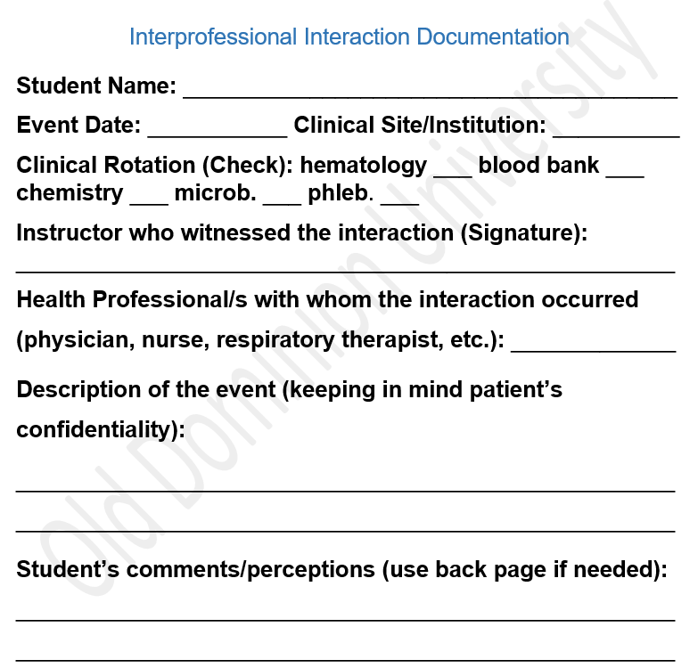
Experiential Learning Model for Interprofessional Education
Angela M. Wilson, MS, M(ASCP)^{cm}; Barbara Kraj, PhD, MLS(ASCP)^{cm}, MB^{cm}
Old Dominion University, College of Health Sciences, Norfolk, VA
Introduction
Methods
Results
Effective interprofessional collaborations
yield better patient outcomes. For this reason, many Healthcare Professions programs have integrated Interprofessional Education (IPE) into their curricula. IPE learning activities typically utilize objective case studies in class-room and group settings. However, George Thibault emphasized that experiential learning is essential to the IPE. “Experiential learning is when students enter a practice environment to understand better how to work collaboratively in real-life situations”(1). The project investigates interprofessional inter- actions of Medical Laboratory Science (MLS) students to develop experiential inter- professional education scenarios for IPE activities.
Students participated in an IPE event in their first semester with focus on IPE objective #2-Roles and Responsibilities defined as “using the knowledge of one’s own role and those of other professions to appropriately assess and address the health care needs of patients and to promote and advance the health of populations.” (2) During clinical rotations students completed at least one interprofessional interaction documentation form (Figure 1) where they indicated in which department and with whom they interacted, providing a detailed account of the interaction, including their perceptions. We collected forms from 2019 through 2022 (n=64) and tabulated the data using Microsoft Excel. Frequency distributions were established based on where interactions occurred (Figure 2), with whom the MLS interacted (Figure 3), and based on the type of interaction as listed (Figure 4). AFINN Sentiment Analysis Tool was used to assist in qualifying narrative perceptions (3).
The most significant number of interprofessional interactions occurred in the chemistry department, 23. Communication of a critical laboratory value was the most frequent reason for interaction, 32 and MLS student interactions with nurses were more than double that of interactions with all other healthcare professionals combined, 48. Sixty-two percent of students provided an account of their personal perceptions of the interaction. Overall, 60% were positive interactions, 5% were negative, and 35% were neutral. Low response rate may be due to time that elapsed between interprofessional education day and clinical rotations, lack of anonymity, or not understanding the instructions.
Discussion/Conclusion
We are collaborating with nursing faculty
to create experiential video recordings for future interprofessional education activities. The videos will illustrate a variety of interaction scenarios created based on the presented data, including calling critical values and issuing blood products. We can also prepare students for interactions that may be unpleasant. Lastly, this data demonstrates the essential role of the MLS on the healthcare team.
Figure 1
References
1. Global Forum in Innovation on Heath Professional Education. Available from: https://www.ncbi.nlm.nih.gov/books/NBK207102/
2. Interprofessional Education Collaborative (IPEC). (2016) Retrieved from: https://ipec.memberclicks.net/assets/2016-Update.pdf
3. AFINN Sentiment Analysis. (2018, October 20). Github - Daren Race - Afinn. https://darenr.github.io/afinn/

