Slide 1
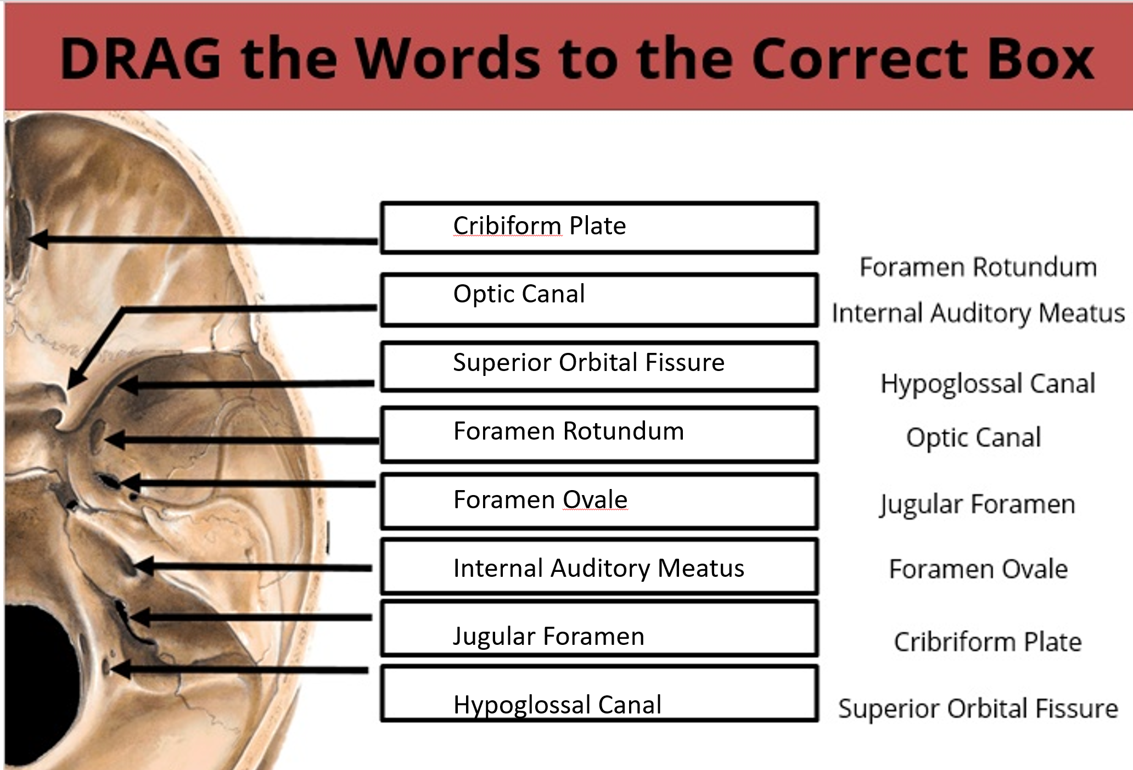
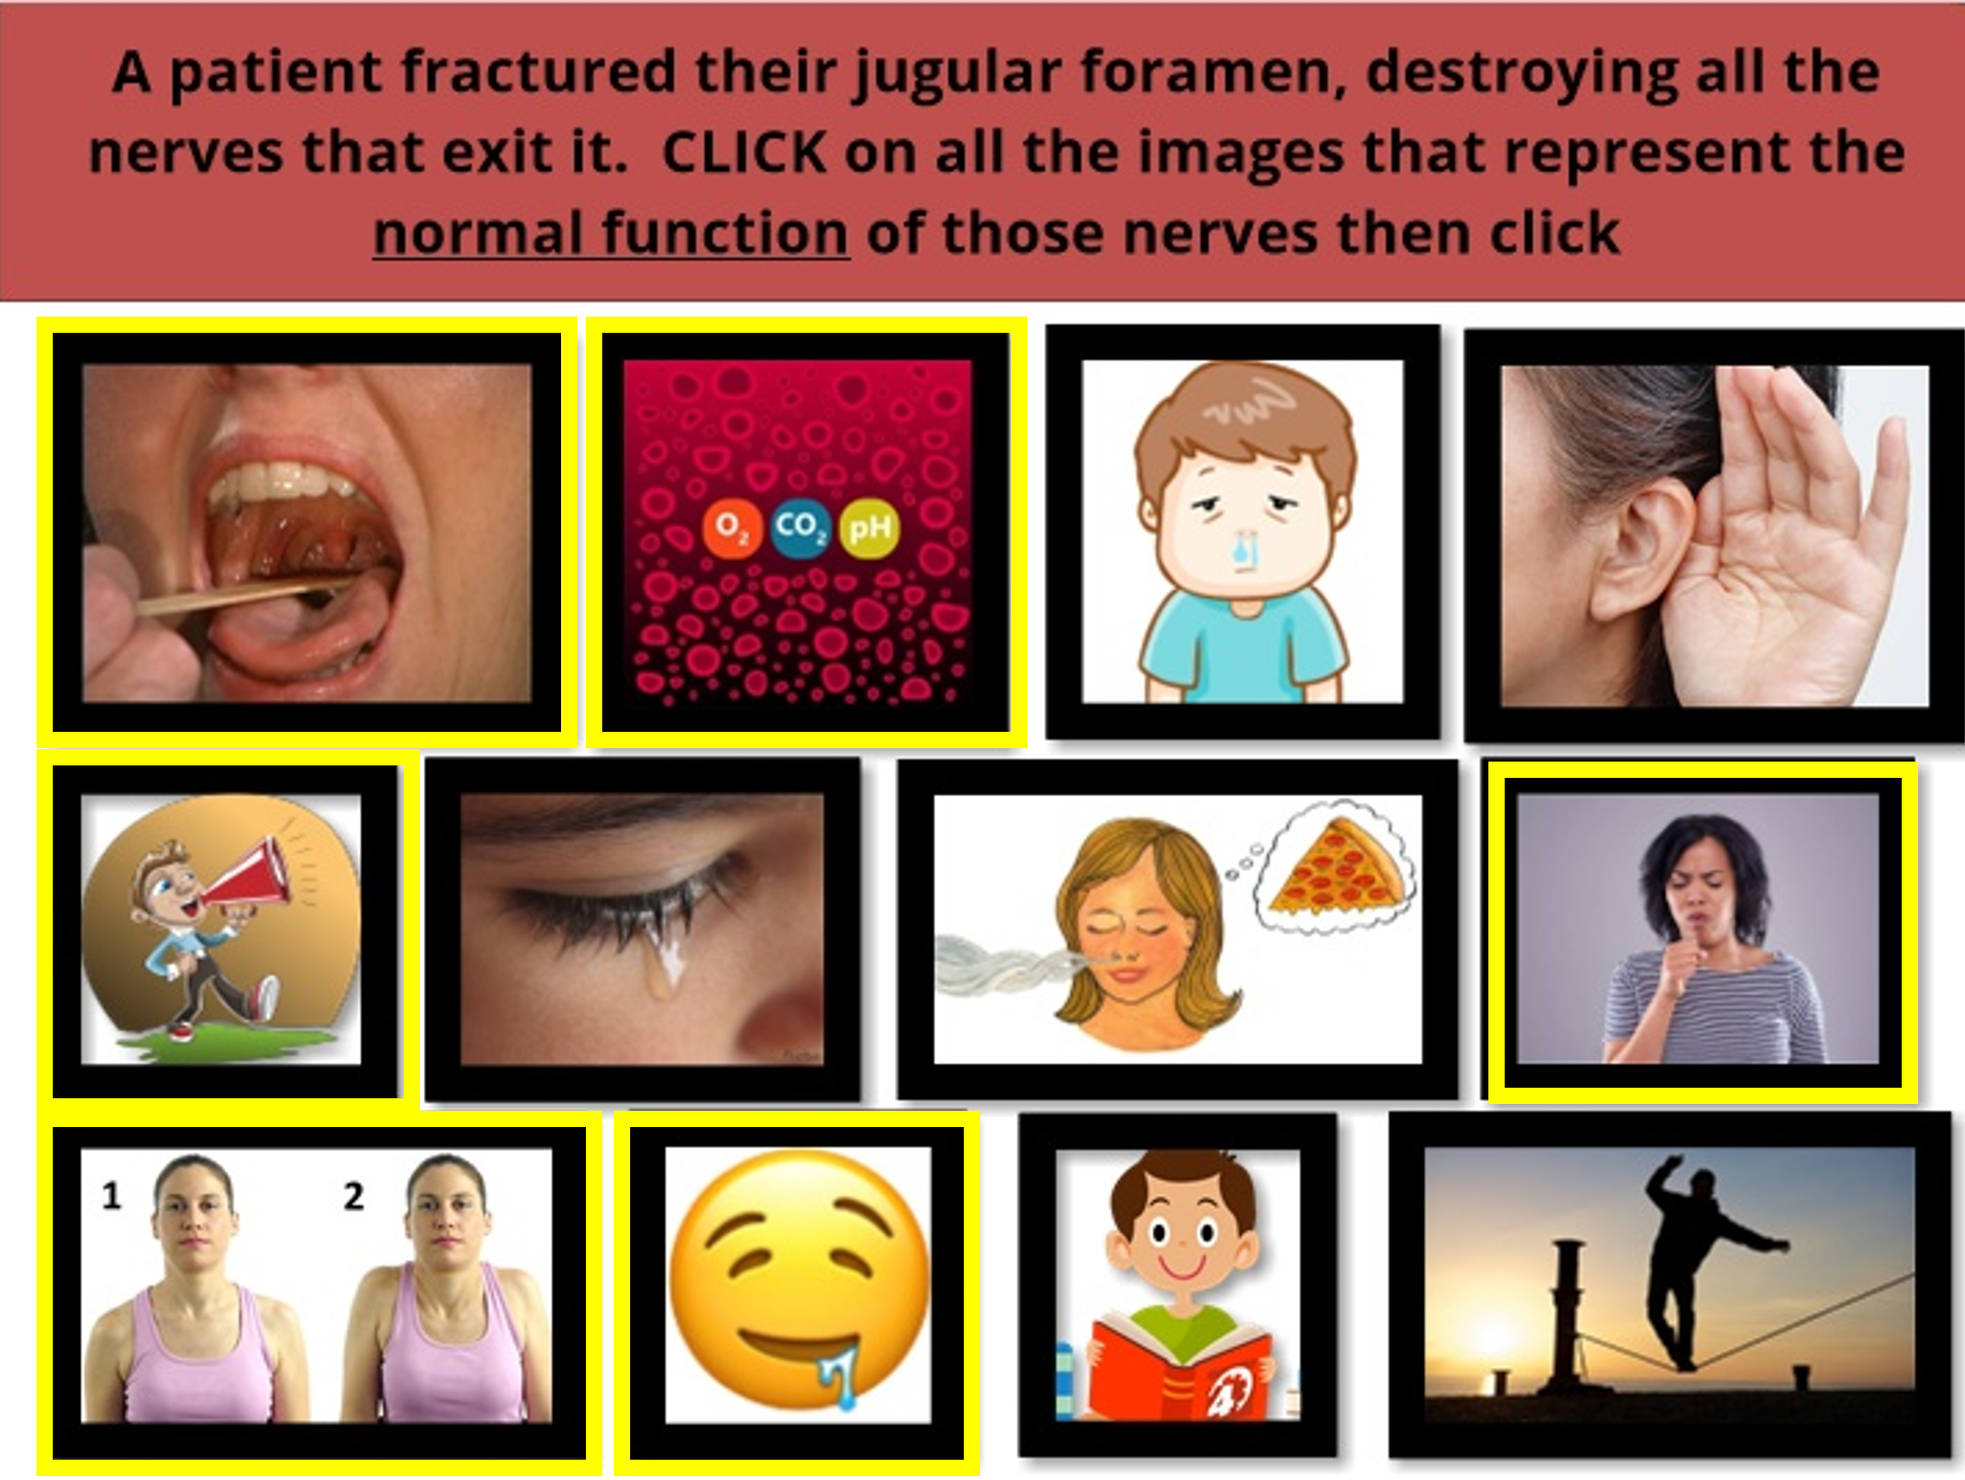
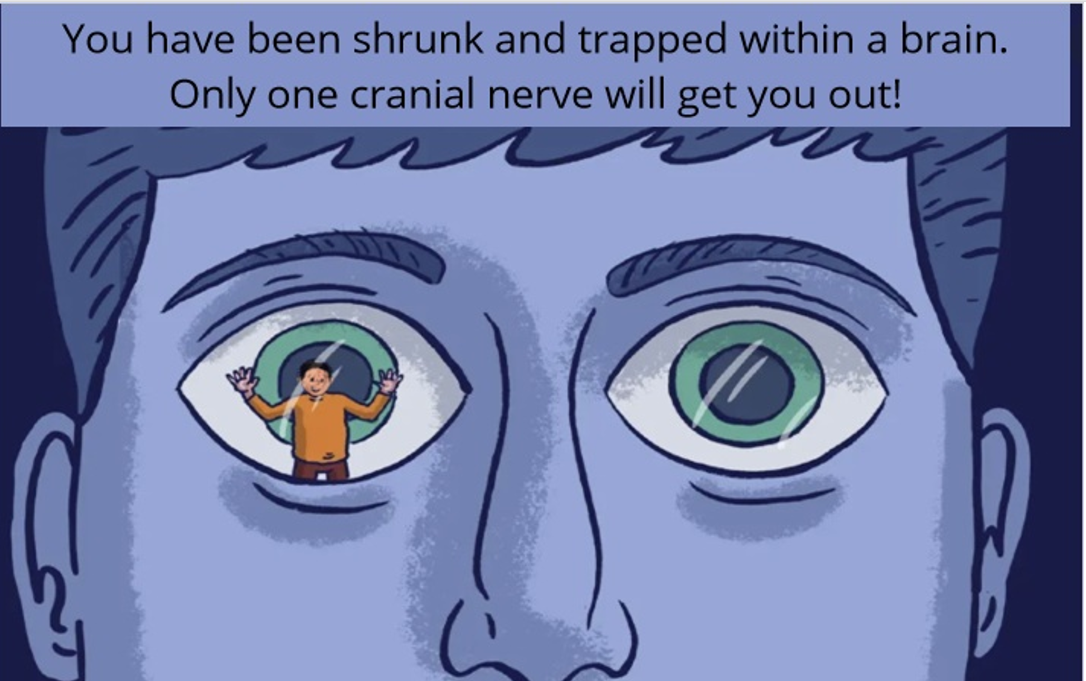
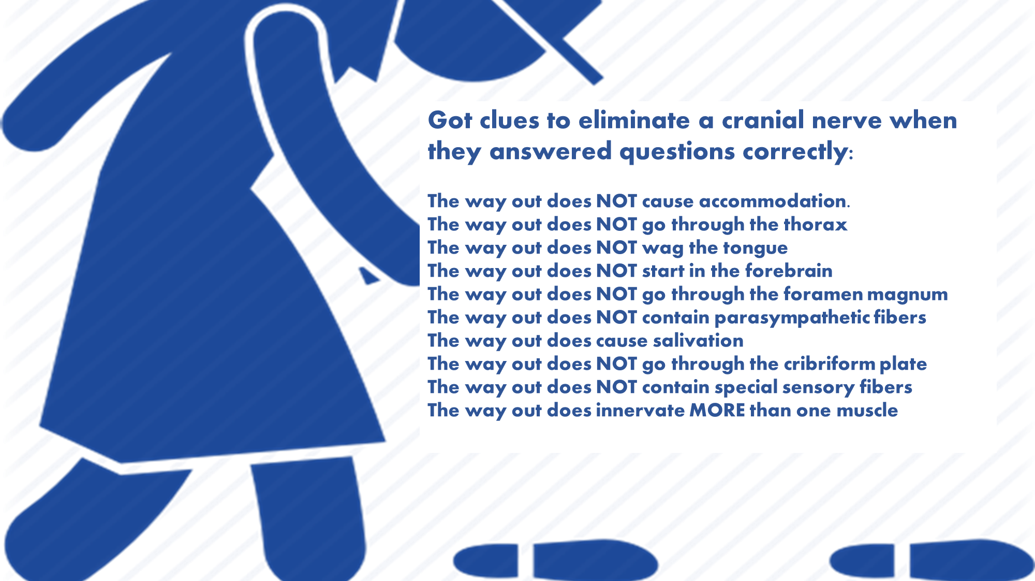
The Effectiveness of a Virtual Escape Room to Review Cranial Nerve Anatomical Knowledge in Medical Education
Mark Velasquez, Jacqueline Shaia, Abhijith Atkuru, Lauren Yoho, and Carrie Elzie Ph D
Eastern Virginia Medical School, Norfolk, VA
Introduction
exit. Following completion of the activity, students repeated a 10-question post-activity competency test. Students also completed a post-activity survey that explored if the activity was useful, if working in teams was effective, and if the activity in general was successful in helping to learn the material.
Results
The popularity of escape rooms as a teaching tool in medical education has grown in recent years. Escape room games have been shown to increase knowledge, self-confidence, and long-term retention. To determine if a virtual escape room could serve as an effective exam review, we implemented a cranial nerve escape room in a graduate-level gross anatomy course with health professions students.
One hundred thirty-nine students completed the pre-test (100%), one hundred twenty-seven students (91.4%) completed the post-test, and ninety-five (68.3%) students completed the post-survey. When comparing the pre-activity and post-activity competency tests, scores improved for all questions with score increases ranging from 8.7% to 29.2%. There was a significant difference (p<0.01) in the overall average pre-test score of 55.1% compared to the post-test score of 70.2%.
Post-Activity Survey (n=95) | %
I found this activity to be a productive use of time. | 82.1
The escape room activity was an effective team building activity. | 90.5
This activity encouraged the use of communication and collaborative skills. | 96.8
I feel more confident about the material after this escape room. | 66.3
The escape room helped expose gaps in my knowledge. | 92.6
I plan to play the escape room again as a review for the exam. | 75.8
The escape room encouraged me to think about material in a new way. | 82.1
I would recommend this activity to others. | 84.2
I learned from my peers during this escape room. | 85.3
The escape room was an effective way to review head and neck anatomy. | 77.9
Figure 2: Example of drag and drop puzzle from escape room.
Methods & Procedures
Conclusions
One hundred thirty-nine (139) Pathologist, Surgical, and Physician Assistant students enrolled in the Health Professions Anatomy course at EVMS participated in a pre-post single-arm pilot as a required, ungraded portion of the course. Students completed a pre-activity competency test which comprised of 10 multiple choice questions on relevant clinical cases. Next, they worked in groups of 4-6 students to complete a virtual escape room built in Articulate Storyline. The concept comprised of students who were “trapped” within the brain and had to solve a puzzle to determine the correct cranial nerve exit. Correct answers revealed a clue to narrow down the correct
The increase in scores on all questions on the post-activity competency test is a strong indicator that the activity was effective at enhancing students’ knowledge of the material. In addition, the majority of students found the activity to be a productive use of time, helpful with team building, and allowed them to feel more confident about the material. The use of an escape room tailored specifically to the curriculum of a graduate-level anatomy course was highly effective as a teaching tool.
Table 1: Results of selected questions from the post-activity survey with combined percentages of participants who agreed or strongly agreed with the statement.
Figure 3: Example of puzzle from escape room.
Figure 1: Example of first picture shown during escape room.
Figure 4: Clues given when a puzzle was solved.

