Slide 1
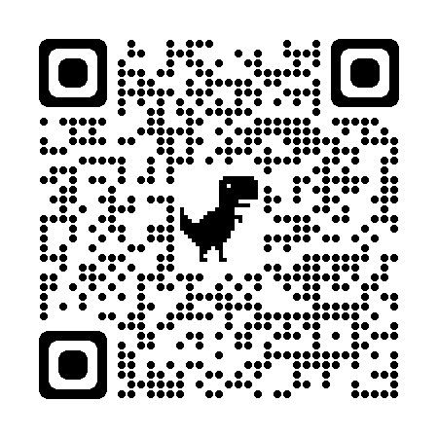
A Multi-Institutional Educational Training for Program Coordinators: How We Got Here and Where We are Going
Lynn M. Vass, C-TAGME
Program Coordinator
Department of Urology
Marleen L. Viola, C-TAGME
Residency Administrator
Department of Radiology
Heather L. Newton, EdD, MEd, C-TAGME
Executive Director
Graduate Medical Education
Introduction
Methods
Kern’s 6 Step Approach to Curriculum Development
Conclusions
In 2022 our institution chose to restructure the Program Coordinator’s job description to include the requirement of TAGME certification. This position restructure brought professional development front and center for our institution and was a driving catalyst for formalizing the Professional Development Series.
The topic of professional development was presented at our 2022 Annual Regional Program Coordinator Virtual Workshop and was highly attended by Program Coordinators throughout our region. Post-survey results reflected the need for more professional development opportunities and a need for multi-institutional collaboration became clear. Soon after the workshop, key stakeholders from several institutions within our region met to begin working on a plan and the next steps.
Collaboration and sharing knowledge with other institutions and/or specialties has substantially enhanced the professional development opportunities, and the collective resources of 8 institutions. Being able to have a program coordinator resource pool of speakers and topics across multiple institutions will allow for a much more robust educational training experience for all who participate. The repository of presentations can be shared and improved upon each year. Lastly, as the ACGME recognizes the importance of wellness for physicians and program coordinators, this is considered wellness as it frees up time and preparation for much needed trainings and spreads the responsibility across multiple institutions.
A problem was previously identified during a regional training workshop that there were not enough educational trainings or opportunities for Program Coordinators around professional development.
A formal and focused needs assessment was conducted with Program Coordinators to identify key stakeholders. Phase 1 occurred within a single institution. Phase 2 was conducted multi-institutional.
Goals and objectives were created to formally organize the curriculum development and monthly meetings. Expectations were set for participation and deadlines were identified for getting new curriculum materials to the training committee.
A learner-centered environment was identified as being crucial. Virtual meetings with key stakeholders determined the educational material that was to be used. GME support was gained prior to implementing the curriculum.
The Professional Development Series was implemented A/Y 2022-23. Resources, protected time, and a safe virtual space were identified.
Evaluations and feedback are currently being received at the end of each training. The overall effectiveness and satisfaction will be surveyed at the end of the academic year.
Problem Identification
Needs Assessment
Goals and Objectives
Educational Strategies
Implementation
Evaluation and Feedback
Sample Resources
Results
Participating Institutions:
Sample of Topics:
Flexible Zoom Trainings
Multi-institutional Engagement
Educational Credits Earned
EVMS
UVA
Centra Health, Lynchburg
Lewis Gale Medical Center
Riverside Regional
Naval Medical Center Portsmouth
Carilion Clinic, Roanoke
VCU
Organize: How to Set Yourself up for Success
TAGME Support Group: Exam Preparation
How to Build a Workshop: Case study using EVMS Dermatology Microaggressions
ACGME and ADS
Work-Life Balance
Certificates Awarded

