Slide 1

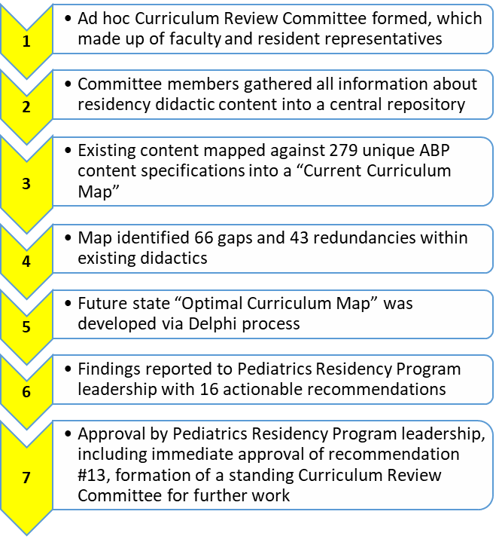
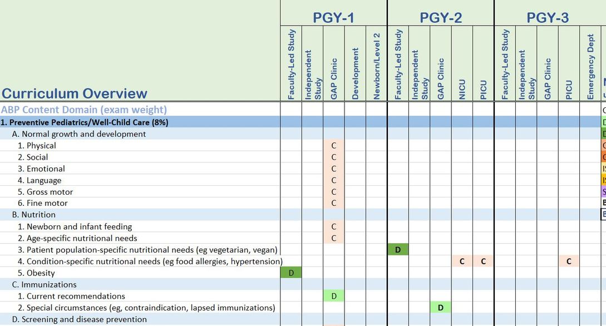
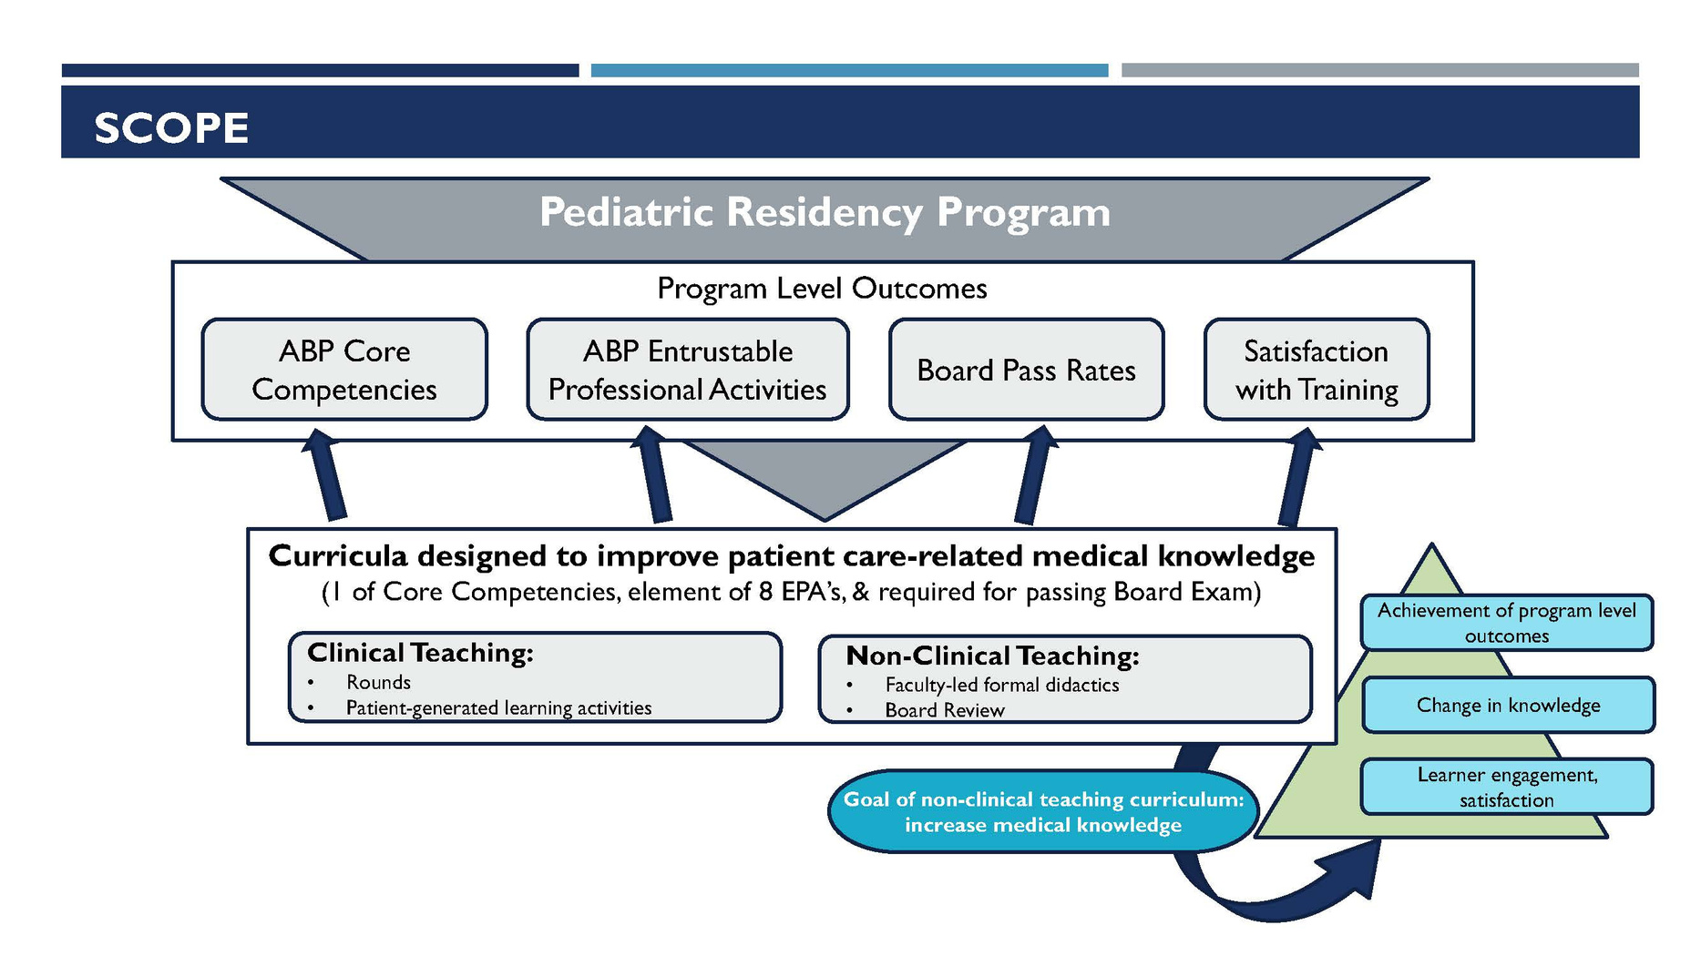
Creation of a Curriculum Review Committee to Structure Achievement of American Board of Pediatrics (ABP) Content within a Pediatrics Residency
Kyrie Shomaker MD, Oneil Grant DO, Megan Brusca MD, Gowry Kulandaivel MD, Heather Newton EdD, Wei-Wei Lee MD, Andria Wallen DO, Nicole Nejedly MD, Meaghan Dominy MD, Anola Stage MD, Keith Foos DO, Allison Racimo DO
Department of Pediatrics
Introduction
  Make recommendations for a curriculum/didactic schedule to ensure ABP content specifications are covered
  Identify gaps and redundancies in the current curriculum.
  Describe how the ABP CS should best be covered within the program's curriculum.
  Suggest process and outcome measures that mark each resident's progress toward the medical knowledge learning goals.
Methods & Procedures
Curriculum Map Sample
The overall pass rate for the ABP Certifying Examination for pediatric residents graduating from CHKD/EVMS has been below the national average in recent years (82% versus 87% from 2014-2019).
During a review of the pediatric didactic curriculum it was noted that:
  There was no mechanism for ensuring coverage of all ABP content specifications (CS) across the residency curriculum;
  The didactic schedule, designed around faculty interests and availability, had both gaps and redundancies with regard to educational content;
  Residents were not held accountable for the progress of their learning with respect to ABP CS, and could not identify areas of weakness until it was too late.
.
1. Ad hoc Curriculum Review Committee formed, made up of faculty and resident representatives.
2. Committee members gathered all information about residency didactic content into a central repository.
3. Existing content mapped against 279 unique ABP content specifications into a "Current Curriculum Map"
4. Map identified 66 gaps and 43 redundancies within existing didactics
5. Future state "Optimal Curriculum Map" was developed via Delphi process
6. Findings reported to Pediatrics Residency Program leadership with 16 actionable recommendations.
7. Approval by Pediatrics Residency Program leadership, including immediate approval of recommendation #13, Formation of a standing Curriculum Review Committee for further work.
Scope
Outcomes/Next Steps
PROVIDE STRUCTURE/OVERSIGHT TO THE DIDACTICS CURRICULUM
ALIGN DIDACTICS WITH PROGRAM OUTCOMES
IMPROVE RESIDENT RESPONSIBILITY FOR LEARNING
ONGOING CURRICULUM REVIEW
MONITORING OF CURRICULUM OUTCOMES
Objectives
  An ad hoc Curriculum Review Committee was assembled by the program leadership in order to evaluate the pediatric didactic curriculum and establish a framework by which the curriculum could ensure coverage of all ABP-recommended content within the 3-year residency.
Acknowledgements
Thank you to Sanaz Devlin, MD, and Rupa Kapoor MD, for their continued leadership and guidance with the Pediatric Residency Program.

