Slide 1
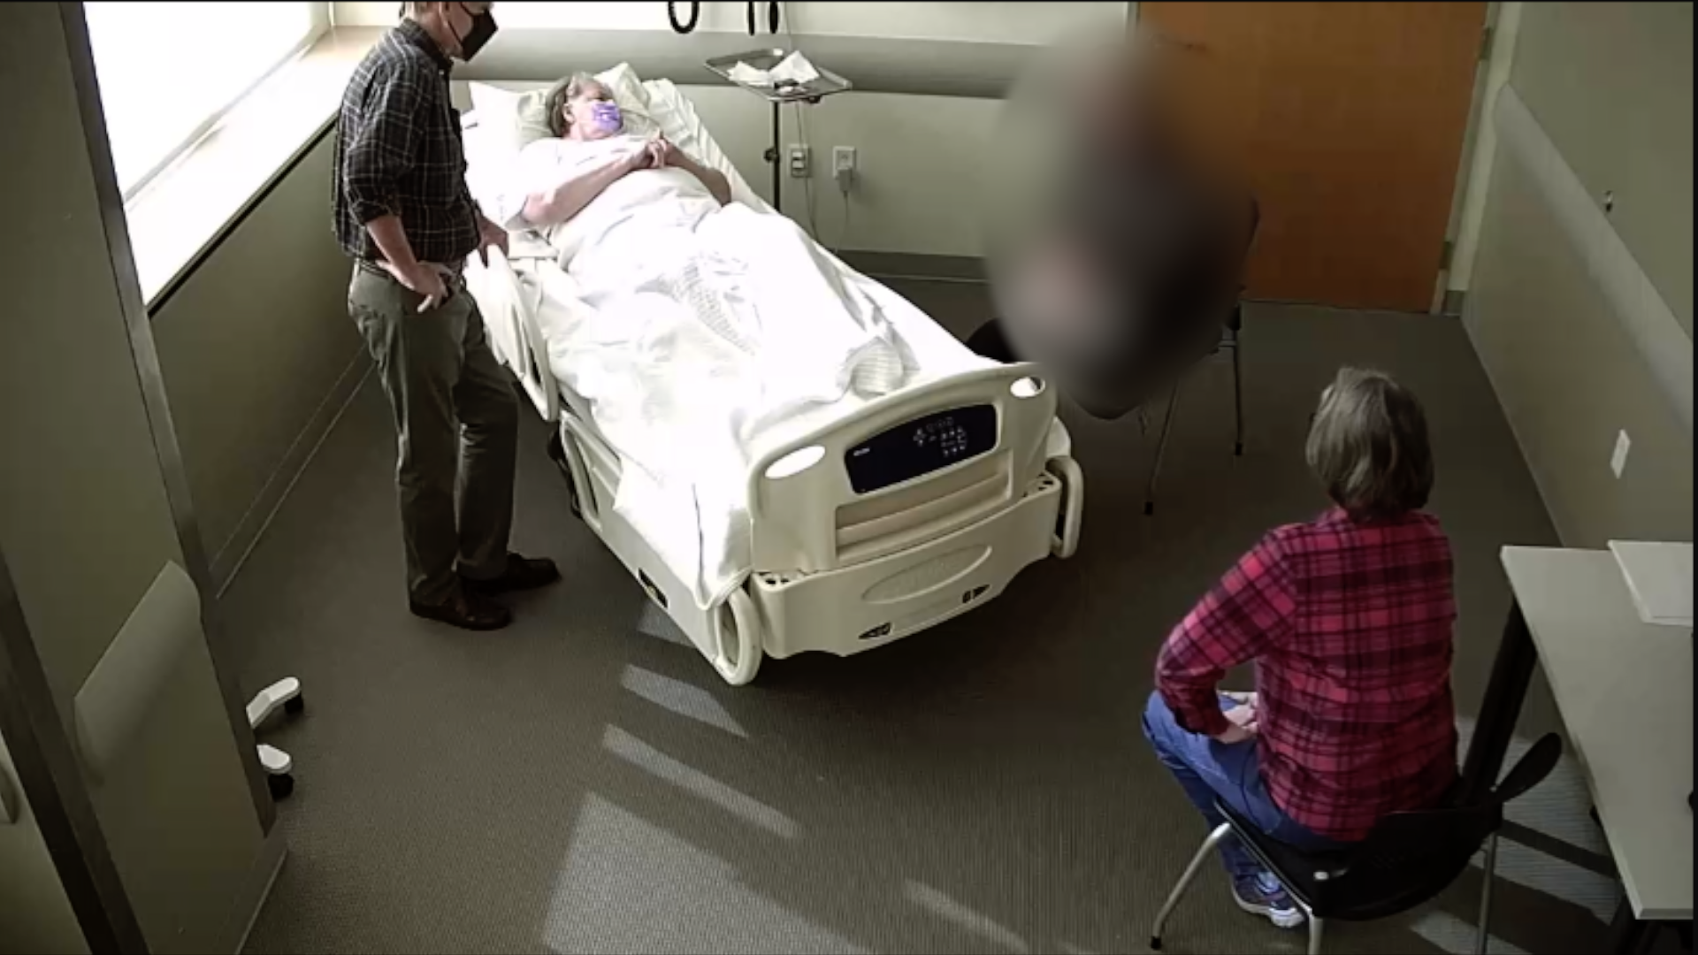


Determining Effective Communication Strategies for Palliative Medicine Family Meetings
Mayuri Kathrotia MS, Marissa Galicia-Castillo MD, Temple West MFA, MMPE, CHSE, Jennifer Styron PhD
EVMS Glennan Center for Geriatrics and Gerontology & Sentara Center for Stimulation and Immersive Learning, Eastern Virginia Medical School, Norfolk, VA
Introduction
Methods
Methods cont.
Goal at Completion
Palliative Medicine meetings have been shown to be an effective method of communicating with patients and their family members. These meetings serve as interchange between health care professionals and patients/families to discuss and understand patient’s goals, values, and preferences along with medical conditions and prognosis in order to engage in shared decision making.
Directing or participating in a Palliative Medicine meeting can be challenging because of the lack of formal training in leading these sessions and the range of skills required for effective communication.
Aims:
  Quantitively measure the length of Palliative Medicine meetings
  Qualitatively describe topics addressed during Palliative Medicine meetings
  Determine the aspects of a “successful” meeting
Retrospectively evaluate 14 palliative medicine videos (from 2019 and onwards) in which a resident or Fellow conducted a Palliative Medicine meeting utilizing standardized patients.
Videos will be transcribed to collect quantitative and qualitative data points (Figure 1).
A checklist (Table 1) was developed to keep track of session content.
 | CHECKLIST :
☐ | Amount of time patient/family spoke
☐ | Amount of time learner spoke
 | Were the following topics addressed:
☐ | “Elevator speech” for Palliative Medicine definition
☐ | Discuss patient’s definition of quality of life (ex. preferences / hobbies / likes)
☐ | Education on CHF diagnosis
☐ | Resources for CHF
☐ | End of life preferences addressed Code status Ventilator use Hospice
 | SP Family satisfaction scores
Determine effective communication strategies that lead to a “successful” meeting.
Analyze data to help inform training and practice guidelines in order to ensure providers are prepared to facilitate effective Palliative Medicine meetings.
Disclosure
There are no financial conflicts of interest.
References
Fineberg IC. Preparing professionals for family conferences in palliative care: evaluation results of an interdisciplinary approach. J Palliat Med. 2005 Aug;8(4):857-66. doi: 10.1089/jpm.2005.8.857. PMID: 16128661.
Singer AE, Ash T, Ochotorena C, et al. A Systematic Review of Family Meeting Tools in Palliative and Intensive Care Settings. Am J Hosp Palliat Care. 2016;33(8):797-806. doi:10.1177/1049909115594353
Figure 1: Image of one of the standardized Palliative Medicine meetings with the resident.
Table 1: Checklist used to evaluate Palliative Medicine meeting content.

