Slide 1
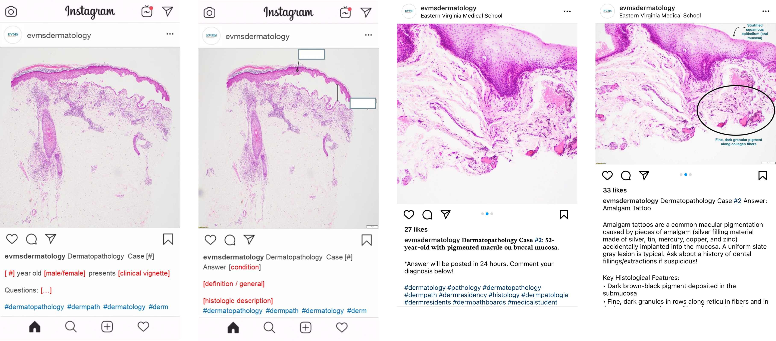
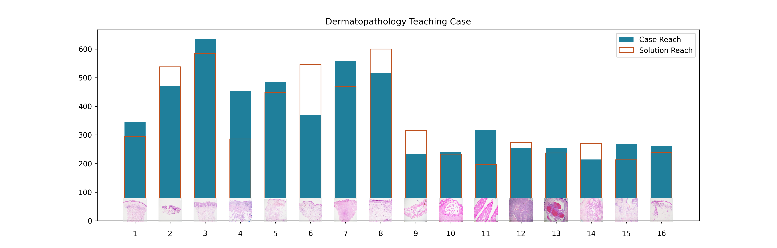
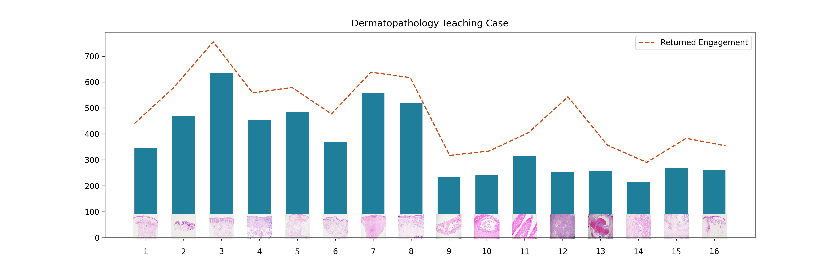
Picture Perfect:
Utilizing Instagram (@evmsdermatology) As A Novel Method for Dermatopathology Instruction
Gregory Hubbard¹, BS; Ryan Saal¹, BS; Jennifer Wintringham², MD; Alice Roberts², MD, PhD
1. School of Medicine, Eastern Virginia Medical School, Norfolk, VA, 2. Department of Dermatology, Eastern Virginia Medical School, Norfolk, VA
Introduction
Procedures
Results
Conclusions
Current literature supports the potential benefit of utilizing social media as an additional medium for medical education. To date, public medical educational profiles are abundant across all major social media platforms (e.g., Facebook, Twitter, Instagram, YouTube, TikTok). Instagram specifically contributes to the evolving landscape of medical education by providing an image oriented, widely accessible, interactive platform.¹ The instructional use case for instagram is actively highlighted by its expanding implementation into radiology, anatomy, and pathology education. ²⁻³ Despite this rapid adoption, niche subspecialties such as dermatopathology currently represent less than 1% of Instagram’s growing medical education demographic.
Eastern Virginia Medical School’s Dermatopathology Teaching Case instagram posts represent a novel solution for medical education. Through instagram’s accessible and engaging user interface, learners may invoke active learning techniques outside of the traditional classroom. The published Dermatopathology Teaching Cases intend to elevate subject education by presenting freely-accessible, high quality, interactive cases for the modern learner.
Demographics | 716
Median Age Range | 25-35
Men | 70.5%
Women | 29.5%
Instagram provides a commonly accessible and interactive platform for the dissemination of medical knowledge. Dermatopathology coursework is ideally curated this visual medium. The described methodology highlights Instagram’s expansive scope and potential to promote active learning in dermatopathology education. Eastern Virginia Medical School’s @evmsdermatology Instagram page provides a novel case framework for further reproducibility throughout similar medical specialties.
Table 1: @evmsdermatology Instagram page demographics (followers). 57.3% followers 25-35.
Dermatopathology Teaching Case Engagement
Reach represents the number of unique accounts that viewed each Dermatopathology Teaching Case. The reach of each case prompt tends to be similar or greater than the reach of its respective case solution. Participation in a question-answer case presentation confers a reference to the preceding (prompt) post upon viewing the solution. This return engagement may be evaluated in the ratio of impression to reach on the initial case post.
Figure 1: Standardized post format (1,2) Actual case post (3,4)
As of April 2023, a total of 16 paired Dermatopathology Teaching Cases have been posted to the @evmsdermatology instagram page.
Instagram Analytics
The learner engagement with Dermatopathology Teaching Case instagram posts was measured using Instagram Insights and Meta Business Suite. Meta Platforms, the current owner of Instagram services, provides data analytics for public business / organizational accounts.
Viewership
Instagram Insights tracks two different metrics of viewership, reach and impressions. Reach refers to the number of unique viewers and impressions refers to the number of total views. The ratio between reach and impressions is indicative of the number of return viewers for each Dermatopathology Teaching Case prompt.
Audience
Instagram users may elect to ‘follow’ other instagram accounts. User data related to @evmsdermatology is collected by Instagram Insights. Demographic data may be used to assess the age, gender, and location of viewers.
References
Douglas, N.K.M., Scholz, M., Myers, M.A. et al. Reviewing the Role of Instagram in Education: Can a Photo Sharing Application Deliver Benefits to Medical and Dental Anatomy Education?. Med.Sci.Educ. 29, 1117–1128 (2019). https://doi.org/10.1007/s40670-019-00767-5
Nguyen VH, Lyden ER, Yoachim SD. Using Instagram as a tool to enhance anatomy learning at two US dental schools. J Dent Educ. 2021;85(9):1525-1535. doi:10.1002/jdd.12631
Azcona Sáenz J, Herrán de la Gala D, Bui PP, et al. Instagram's Influence on Radiology Today: Reviewing the Evolving Educational Journey from a Hospital to National Societies. J Digit Imaging. 2021;34(5):1316-1327. doi:10.1007/s10278-021-00474-x
Methods
Dermatopathology Teaching Case Format
The format of @evmsdermatology includes a series of dermatoscopic images and brief clinical history, followed up 24 hours later with a reveal of the diagnosis, annotated images, and discussion, and occasionally an interactive quiz.
Figure 2: comparison of unique viewers against dermatopathology teaching case paired case/solution
Figure 3: returned engagement ( impression : reach ) on initial case prompt

