Slide 1

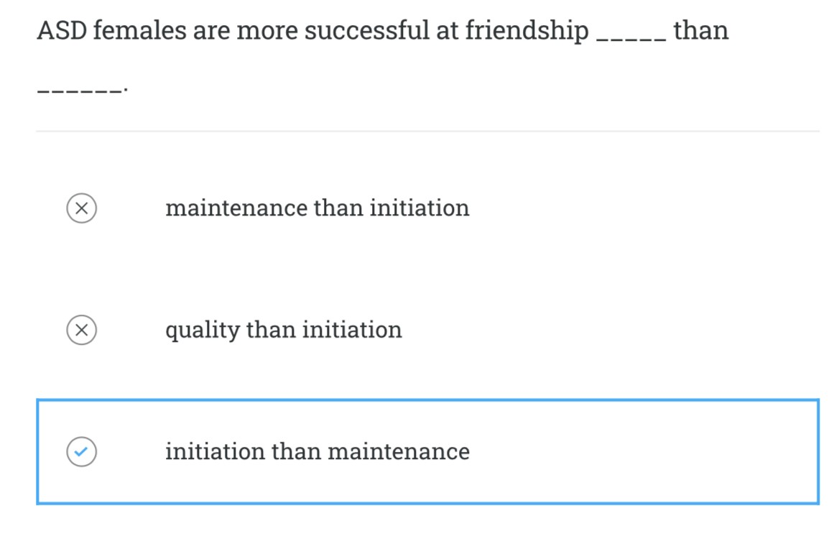
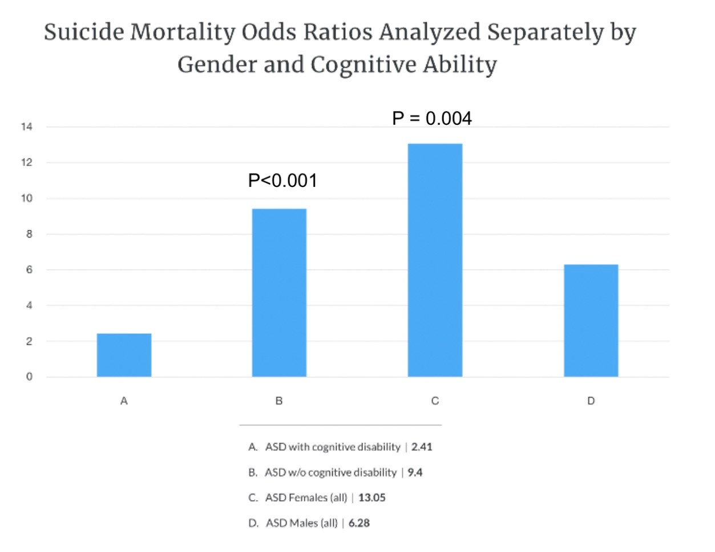
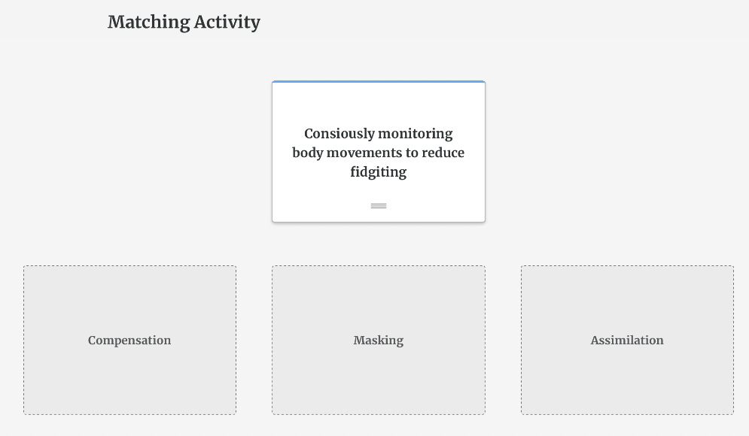
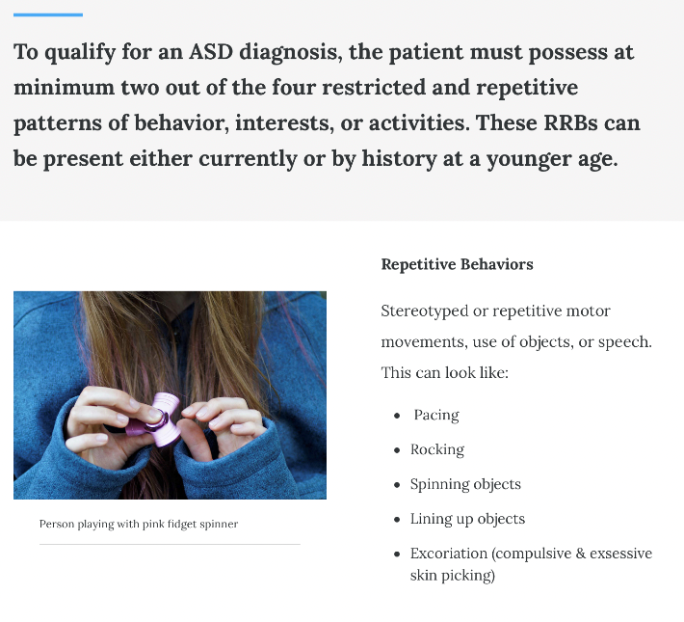
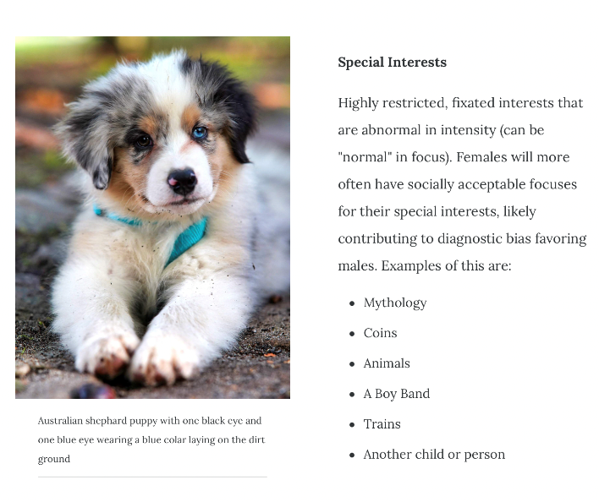
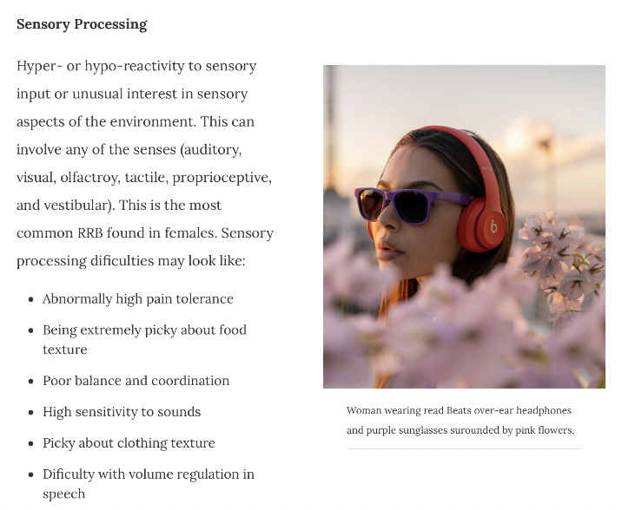
Investigating the Efficacy of a Female Autistic Phenotype Educational Module
Alexandra Alvarez, BS, Amanda Burbage, PhD, and Jessica Bergden, PhD
CHAP, Eastern Virginia Medical School, Norfolk, VA
Background
Methods: Module Development
Methods: Module Development
Significance & Intersectionality
Autism spectrum disorder (ASD) is a grouping of neurodevelopmental disorders presenting with social communication and interaction deficits as well as stereotyped restrictive and repetitive behaviors. Autism research has historically focused on males leading to a predominantly male-based understanding of ASD. Therefore, health care professionals are lacking vital knowledge of the phenotypic differences between the male and female ASD presentations.
The expression of ASD most commonly found in females is exhibited by:
Social Motivation
Camouflaging
Internalizing Disorders
Restrictive and repetitive behaviors
Current literature shows that autistic females are both underdiagnosed and often misdiagnosed with other psychiatric conditions^{2,5}.This project aims to fill this gap by providing healthcare professional students an educational module designed to inform future healthcare professionals about the female autism phenotype (FAP).
An educational e-Learning module reviewing female ASD diagnostic criteria is currently being developed describing each of the four domains of FAP. Each section consists of interactive assessments to ensure competency prior to progressing within the module.
Social Motivation
It is extremely important that research into the female autism phenotype continues to grow. However, it is also imperative to remember that the “Female” presentation of ASD can be found
ASD females have greater motivation to pursue relationships and take great efforts to do so.
Example of a MCQ knowledge check in the module.
in any autistic individual of any gender. Conversely, some females may have more stereotypically "male” ASD traits.
There is a glaring lack of research targeting non-binary and transgender autistic people. The autism community is more gender diverse than the general population; 24% of gender-diverse people are autistic^{1,6} highlighting the need for future broader gender diversity when educating students on autism diagnostics and treatments.
Methods: Module Content & Features
Internalizing Disorders
Excess mortality rates within the autistic population found that excess mortality for suicide was higher in those without intellectual disability (OR= 9.40) and highest in females (OR=13.05)⁸
Future Directions
MODULE
IMPLEMENTATION
Incorporate ASD female video
interviews into module
Implement module
& assess its efficacy
Camouflaging
Module Implementation
Camouflaging → Internalizing Disorders^{3,4,6}
A
B
C
D
Compensatory communication strategies (ex. scripting conversations, or studying social behaviors).
Example of a matching knowledge check in the module.
ASD with cognitive disability 2.41
ASD w/o cognitive disability 9.4
ASD females (all) 13.05
ASD males (all) 6.28
Increase gender diversity in
future ASD research
GENDER INCLUSIVITY
Anxiety
Depression
Suicidal Ideation
Eating Disorders
Restrictive & Repetitive Behaviors
Gender Inclusivity
References
Dattaro, Laura. Gender and Sexuality in Autism, Explained. (2020, September 18). Spectrum.
Hull, L., Lai, M.-C., Baron-Cohen, S., Allison, C., Smith, P., Petrides, K. V., & Mandy, W. (2020). Gender differences in self-reported camouflaging in autistic and non-autistic adults—Autism : The Int. J. of Research and Practice, 24(2), 352–363.
Hull, L., Levy, L., Lai, M.-C., Petrides, K. V., Baron-Cohen, S., Allison, C., Smith, P., & Mandy, W. (2021). Is social camouflaging associated with anxiety and depression in autistic adults? Molec. Autism, 12(1), 13.
Methods: Module Assessment
Lai, M.-C., Lombardo, M. V., Auyeung, B., Chakrabarti, B., & Baron-Cohen, S. (2015). Sex/Gender Differences and Autism: Setting the Scene for Future Research. J. of Am. Ac. of Child & Ad. Psychiatry, 54(1), 11–24.
Instrumentation measuring:
FAP Knowledge
FAP Awareness
Confidence in recognizing the FAP presentation was developed.
Once the module is piloted and scores are obtained, an independent t-test will measure differences in pre-test and post-test scores before and after completion of the module. All statistical tests will be performed at the p=0.05 level.
Loomes, R., Hull, L., & Mandy, W. P. L. (2017). What Is the Male-to-Female Ratio in Autism Spectrum Disorder? A Systematic Review and Meta-Analysis. J. of Am. Ac. of Child & Ad. Psychiatry, 56(6), 466–474.
Warrier, V., Greenberg, D. M., Weir, E., Buckingham, C., Smith, P., Lai, M.-C., Allison, C., & Baron-Cohen, S. (2020b). Elevated rates of autism, other neurodevelopmental and psychiatric diagnoses, and autistic traits in transgender and gender-diverse individuals. Nat.Comm., 11(1), 3959.
Aims
Create a module to educate EVMS healthcare professions students about the female autism phenotype
Assess the effectiveness of the module to recognize FAP symptoms
Improve access to diagnosis, services, and treatment
Restricted and repetitive patterns of behavior, interests, or activities.
Repetitive motor movements
Special interests
Insistence on sameness
Sensory differences
Whitlock, A., Fulton, K., Lai, M.-C., Pellicano, E., & Mandy, W. (2020). Recognition of Girls on the Autism Spectrum by Primary School Educators: An Experimental Study. AR, 13(8), 1358–1372.
8. Hirvikoski, T., Mittendorfer-Rutz, E., Boman, M., Larsson, H.,
Lichtenstein, P., & Bölte, S. (2016). Premature mortality in autism spectrum disorder. British J. of Psychiatry, 208(3), 232–238.

