Slide 1
Dual Use Research of Concern
US Government (USG) Policy for Institutional Oversight of Life Sciences
10/13/2014

Slide 2
Background
Release Date: September 24, 2014
Effective Date: September 24, 2015
Policy “articulates the practices and procedures required to ensure that dual use research of concern is identified at the institutional level and risk mitigation measures are implemented as necessary”

Slide 3
Scope of Policy
15 agents
Seven (7) categories of experiments

Slide 4
Applicability
USG departments and agencies that fund or conduct life sciences research
Institutions that both:
  Receive USG funds for life sciences research
  Conduct or sponsor research that uses one or more of the 15 agents

Slide 5
DURC Agents
Avian influenza virus (highly pathogenic) | Bacillus anthracis | Botulinum neurotoxin*
Burkholderia mallei | Burkholderia pseudomallei | Ebola virus
Foot-and-mouth disease virus | Francisella tularensis | Marburg virus
Reconstructed 1918 Influenza virus | Rinderpest virus | Toxin-producing strains of Clostridium botulinum
Variola major virus | Variola minor virus | Yersinia pestis
*No exempt quantities for DURC

Slide 6
Categories of Experiments
Enhances harmful consequences of agent/toxin
Disrupts immunity or effectiveness of immunization
Confers resistance to prophylactic or therapeutic intervention, or facilitates agent’s ability to evade detection methods

Slide 7
Categories of Experiments
Increases stability, transmissibility, or ability to disseminate agent
Alters host range or tropism of agent
Enhances susceptibility of host population to agent
Generates or reconstitutes an eradicated or extinct DURC agent or toxin

Slide 8
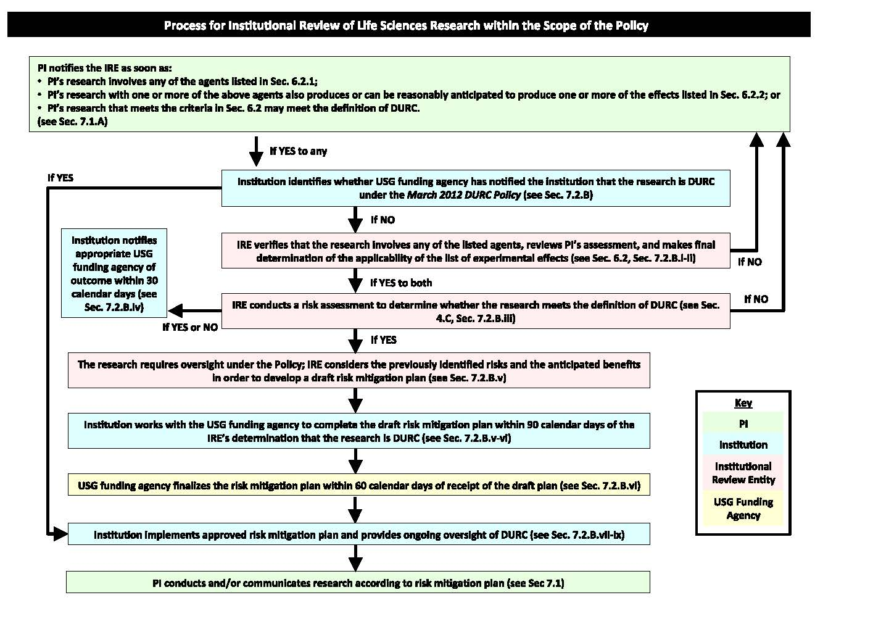

Slide 9
Components of Oversight System
Identification, by the PI, of DURC research
Institutional review
  For assessing whether one or more of DURC agents and toxins used
  Applicability of one or more DURC categories of experiments
Identification of anticipated benefits, in conjunction with the risks, in order to develop a “risk mitigation plan”

Slide 10
Components of Oversight System
Notification of review process results to relevant USG funding agencies
  Non-USG funded research – notify NIH
Institutions certify compliance with DURC Policy
Oversight by USG funding agencies and the USG

Slide 11
Responsibilities of PIs
Notify Institutional Review Entity (i.e. the IBC) when research uses DURC agents or fits in DURC category
Work with IBC to assess research’s risks and benefits
Conduct research in accordance to risk mitigation plan

Slide 12
Responsibilities of PIs
Be knowledgeable about and comply with all institutional and USG DURC policies and requirements
Ensure lab personnel receive a copy of the USG Policy
Communicate DURC in a responsible manner

Slide 13
Responsibilities of Institution
Establish and implement internal policies that provide for identification and oversight of DURC
When DURC is identified, initiate institutional review process
Ensure internal policies establish a mechanism for PI to immediately refer a project to IBC

Slide 14
Responsibilities of Institution
Designate an Institutional Contact for Dual Use Research (ICDUR) for questions regarding compliance
Establish an Institutional Review Entity
Maintain records of DURC reviews and completed risk mitigation plans
  For the term of research grant/contract + 3 years
  No less than 8 years

Slide 15
Responsibilities of Institution
Provide training on DURC for those conducting DURC research, and maintain training records for grant term + 3 years
Ensure compliance with USG Policy and with approved risk mitigation plans
Assist PI when oversight questions arise

Slide 16
Responsibilities of Institution
Establish internal mechanism for PIs to appeal institutional decisions regarding IBC-determined DURC
Make info about review process of DURC research available upon request
When applying for USG funds, certify that institution will be/is in compliance with USG Policy

Slide 17
IBC Review Steps of DURC
Verification PI-identified research
  Uses one or more DURC agents
  Qualifies in one or more DURC experiment categories
Notify USG funding agency of DURC review within 30 calendar days of IBC’s review
Identify the anticipated benefits of research identified as DURC

Slide 18
IBC Review Steps of DURC
Provide draft risk mitigation plan to USG funding agency within 90 calendar days of IBC’s DURC-determination
Implementation of risk mitigation plan
Review, at least annually, all active risk mitigation plans

Slide 19
IBC Review Steps of DURC
Notify USG funding agency within 30 calendar days of
  Any change in status of a DURC project at institution
  Details of any changes to risk mitigation plans (such changes need to be approved by funding agency)

