Slide 1

Leadership to Improve Hispanic Health: A Role for Health Professionals
Elena Rios, MD, MSPH, FACP
President & CEO
April 11, 2018

Slide 2



Hispanics account for a large and growing share of the population in the United States.
2015:
About 53 million people living in the U.S. are Hispanic, making up 1 in 5 of the population.
2045:
Hispanics are projected to account for 1 in 4 people living in the U.S. by 2045.
SOURCE: Kaiser Family Foundation analysis based on March 2016 Current Population Survey, Annual Social and Economic Supplement, U.S. Census Bureau, Projections of the Population by Sex, Hispanic Origin, and Race for the United States 2015 to 2060, http://www.census.gov/population/projections/data/national/2014/summarytables.html.

Slide 3
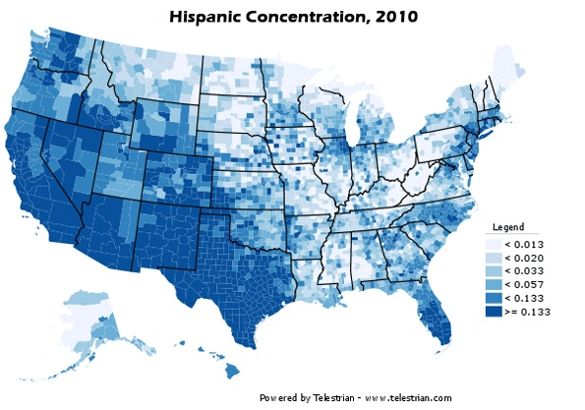
Demographics

Slide 4
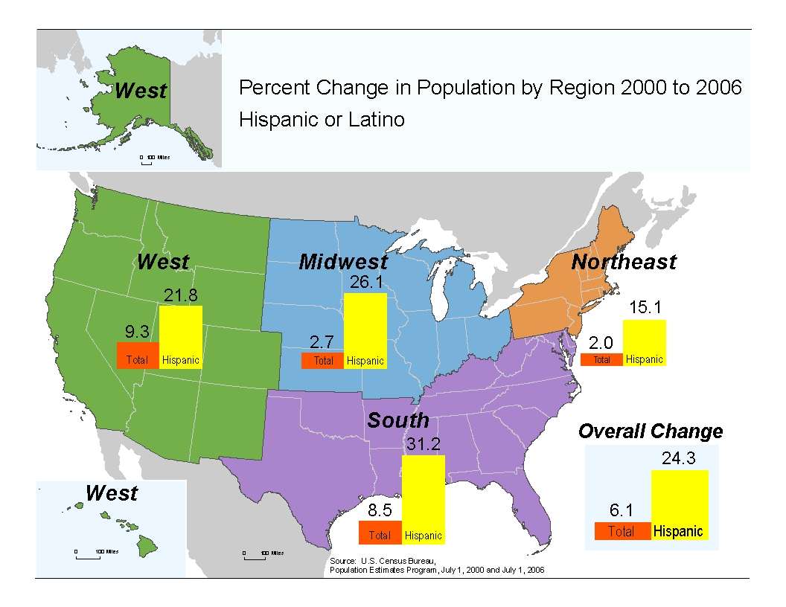
Demographics

Slide 5
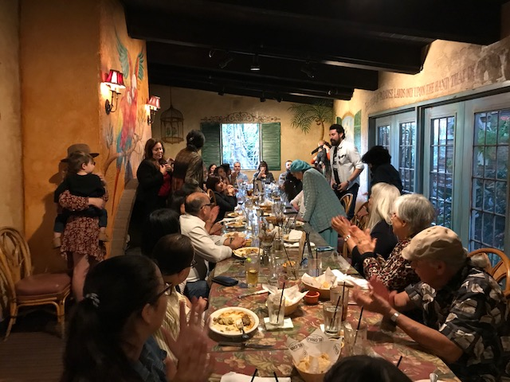

Mexican Americans – East Los Angeles, CA

Slide 6
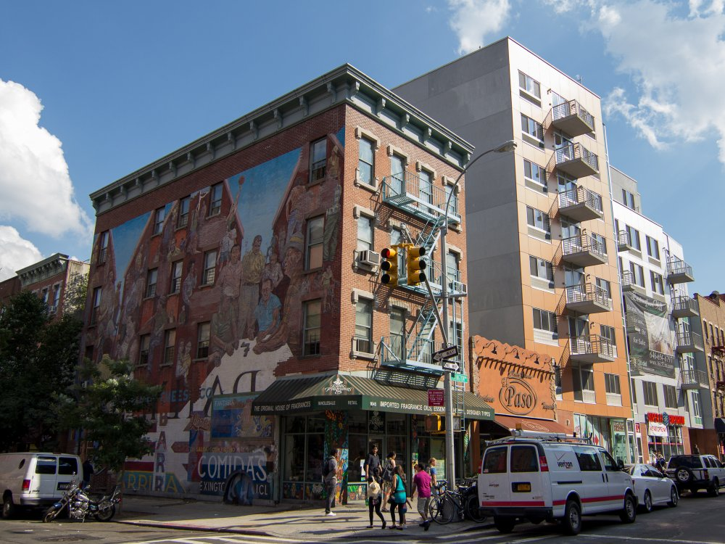
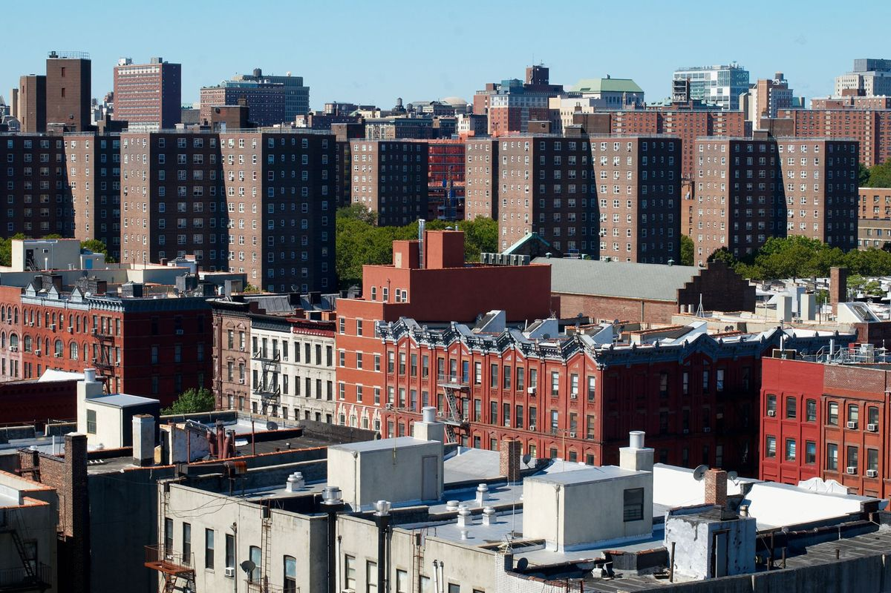
Puerto Ricans - East Harlem, NYC

Slide 7
The uninsured rate for Hispanics declined significantly after the ACA, but they still face disparities in coverage.
Uninsured Rate Among Nonelderly Individuals, 2013-2015
Note: Includes nonelderly individuals 0-64 years of age.
Source: Kaiser Family Foundation analysis of March 2014-2016 Current Population Survey, Annual Social and Economic Supplement.

Slide 8
Social Determinants of Health: measures needed
Poverty/income – uninsured
Housing – crowded living, dilapidated, not fit for disabled
Food security – less access to fruits and vegetables
Transportation – to leave the neighborhood
Financial literacy – less savings
Education – Low literacy rates, less ability to fill out applications
Employment
Homeless – lack of stability, social network
Prison experience – less ability to function, job skills - in society

Slide 9
Congress Legislation 115th Congress
Health Insurance Reform
  ACA is still law of the land
Research
  21st Century Cures Act
  All of Us Research Program
  Study of Latinos
CDC Cancer, Diabetes, Heart, HIV, Zika, Opioid Prevention Programs
Health Workforce Programs – HRSA, Dept of Ed
  Diversity Recruitment and Training, Faculty Development, Scholarships
  Higher Education Act Reauthorization, GME block grant request
Minority Health – HEAA 2018 in progress
  Cultural Competence/Language
  Value based care

Slide 10
Health Policy Trends
Polarization among Congress
  Medicare for All – Dems
  FY19 Budget – block grants, market-based grants
Bipartisan support – CSRs, Market place
Reinsurance, new Copper Plan at State level
Medicare Advantage – now 30% > 65 y.o.
Social Determinants of Health focus
Society Trends- Tax bill impact, demographics, millennials, AI and data, disruption in healthcare

Slide 11
Health Care Trends- Medicaid
Medicaid now largest insurance program with new focus on Flexibility at State Level:
  Work requirements in 10 state waivers
    Need to consider transportation, child care, family dynamics
  Drug pricing
  Health Savings Accounts
  Wellness programs – incentives for providers
  Premiums
  Telehealth
  Social determinants of health
  Outreach

Slide 12
Federal Strategic Plans
US Department of Health and Human Services Strategic Plan – focus on high risk populations, faith based and other organizations
HHS OMH National Plan to Eliminate Disparities
  NPA, Regional Health Equity Councils & CLAS Standards
AHRQ Quality and Disparities Report
IOM Unequal Report – disparities for chronic diseases
Healthy People 2020, 2030
New Secretary Azar: drug prices, ACA, opioids

Slide 13
Patient-Centered Care
Aftercare services education
Target care to the most in need
Care Coordination (physicians/nurses):long-term and home-care
Teach families, care givers self-management skills, ER visits
Maintain functional physical activity to decrease declining mobility and to assess activities of daily living
Reimbursement higher if physicians in the Patient-Centered medical home or health home (clinics)
Enhanced state match for Medicaid medical home models

Slide 14

NHMA Cardiovascular Summits
Purpose: to bring together healthcare professionals, community leaders and policymakers to develop recommendations on ACCESS, PREVENTION and MEDICAL EDUCATION to improve Latino patients with CVDz
2017 Summits with 300 participants
  Austin, March
  NYC, June
  Los Angeles, August
Report to be discussed in 2018 – Congress, Latino Conferences, Social Media and Media

Slide 15
Latino Individual’s Barriers
Mentality of Fatalism – E.g., “Si Dios Quiere”
Literacy
Shame
Lack of trust in physicians who have no cultural competence/language
Language: Cultural competency – Inherent bias present
Time & Resources
  Family schedules, Multiple Jobs, Money for Transportation, Cargivers (family)
Insurance – Lack of equitable coverage/care/medications
New medications’ high prices but effectiveness
Under representation in research & screening (Ex: ACC/AMA Guidelines)
Immigration Status
Subgroup research needed – CVDz (HTN, cholesterol, MI, Stroke) varies

Slide 16
Prevention Policy - Community
Promote awareness of cardiovascular disease prevention
  Obesity, Diabetes, High Blood Pressure, Cholesterol, Smoking Programs
  Federal clinics, NHSC, PHS, Indian Health Service, prisons, substance abuse and other programs that are local
  Surgeon General and Region Directors leadership campaigns
Provide individuals and families with information and tools to be able to follow provider's advice in daily life, such as health literacy, language services, health system navigation, and self-care in community.
Worksite Wellness Programs – stress reduction, healthy behaviors
Family Programs – Community – Parks, Senior Centers

Slide 17
Prevention Policies - Community
Nutrition
  Incorporate nutrition classes in education for children/adolescents
  Develop Latino-based diet cooking, shopping programs – home involvement
  Continue to support WIC, SNAP, school meal programs
  Promote locations that offer healthy foods
Physical Activity
  Home care should include education on activity
  School policies should include PE - should have educational component with strong evaluation & data collection for better outcomes
  Know what patients’ like to do – increase routine of dancing, walking, jogging

Slide 18
Prevention Policies - HealthCare
Improve Behavioral Health, creating an effective behavioral system that is efficiently integrated with other health sectors in order to ensure that the complete needs of complex patients are addressed.
Data collection/metrics to measure racial/ethnic health disparities.
Collaborate with the health care systems, providers and payers to show the value of greater investment in community based prevention approaches that address underlying determinants of poor health and chronic disease
Educate clinicians and the public about coverage improvements for clinical preventive services as outlined in the Affordable Care Act.

Slide 19
Prevention Policies - Healthcare
Education programs for all Providers needed
Know who has biggest influence on patients
Multigenenerational education (technology, apps, cell phones)
Understand what motivates people to make healthy changes
Culturally competent translation services
Print materials in Spanish & plain language
Respect the social condition of the patient
  American Heart Associations “Life’s Simple 7” Metrics
  Reduce fast food/sodas/sugar advertising, focus on home cooking/water
Assessment of Mental health
Funding needed for prevention services

Slide 20
Access Policies - Community
Urban Planning
  For transportation, housing, parks, bike/walking zones
  Disease-focused community outreach, local collaboration and communication
  Advocacy for pt/family centered care
  Senior centers should be a focus for outreach/include more patients with CVDz
Immigrants Access to Healthcare
  Safe Havens Centers to minimize fear
  Sanctuary Health Centers and Zones

Slide 21
Access Policies - Healthcare
Increase state funding for targeted Medicaid plus low SES population programs like clinics, local health departments, coalitions with non-profits, Latino health professional orgs.
Utilize Healthcare educational initiatives, reminders.
Checklists for CV disease.
  Learn what to look for
  Learn about the benefits of lifestyle changes
  Have standardized guidelines for follow-up & monitoring adherence
Payment system for social services – seniors, meals, transportation, home health.
Coordinated care: (RNs): health plans & providers about chronic dz patients.
Clinical guidelines for lipid screening (ACC/AHA differ) should be consistent and used.
Enforce access based on Language and Race/ethnicity, Social Determinants of Health.

Slide 22
Access Policies - Healthcare
Address how services are utilized/address Barriers (E.g., Long wait time)
Dwindling Capacity of Providers, develop patient navigators/cargiver programs
Serious Access Issues (PCP to Patient ratio)
Coordinate Care across point of care: acute/chronic/rehab/long term/home
Connect Home Health Care with community programs (focus on the middle class for solutions of funding new programs)
Expand use of health information technology to remind, provide feedback and incentivize clinicians and health care systems.
Physical and Behavioral Health needs convergence

Slide 23
Access policies – Insurance Reform
Expand access to comprehensive statewide data with flexible reporting capacity to meet state and local needs.
Provide equitable and affordable access to high quality health care using a patient centered approach.
Expand modalities of primary care services to include reimbursable email, phone based care, web portals for self management, group visits, and integrated medical and behavioral health visits.
Expand public and private insurance coverage of and reimbursement authority for community, preventive services per evidence-based guidelines.
  Population Health programs including philanthropy
  Evidence-Based Programs
  Adherence to follow-up appointments
  Transparency on medications formularies, networks of physicians
  Adjust authorizations, applications for enrollment, and appeals processes

Slide 24
Medical Education Policies
Curriculum
  Introduce preventive medicine/social determinants of health into curriculum
  Team based training needed – esp with pharmacists, dietitians, nurses, doctors
  Pilot programs with teaching clinics, community hospitals and Latino residents, doctors – mentoring
  Medical Spanish mandate
Cultural Competence
  Making it more visual to educate – (using visuals to better educate by considering different learning styles and attention grabbing)
  Trust building, Case Studies/Families
  Scope of work issues – need more nurses, allied health, pharmacists participation
Incorporate Humanism with Interactive/Inter-personal skills
Offer a course that immerses health professionals in the community to develop understanding.

Slide 25
Medical Education Policies
Institutional Racism/Biases of Providers re: Patients
  More care coordinators to translate the care/funding needed/connect the dots
  Ongoing training/grants for certification/Job description of community health workers
  Access through partnership with providers – health systems and CBOs/insurance philanthropy should increase
Targeted list of doctors & clinics for reduced/discount services/copayment – charity care
Caregiver training → Hispanics with heart patient’s needs

Slide 26
Medical Education - Diversity
Offer a course that immerses health professionals in the community to develop understanding.
Create an affinity group with National Hispanic Medical Association about educating healthcare professionals.
Offer internships/Immersive experiences to work with/and in the Latino communities
  And with a mentor (humanism, CVH) – understanding the patient population & improving advocacy on the patients behalf
Hospital staff going into the community (Latino) to present about preventive care among Latinos
  Joint Community & Medical Representatives to provide credibility on both levels
Elevate the role of our Latino physicians and other health professionals
What is the role of accreditors around Diversity, Cultural Competence preparation and Continuing Education?
How do you leverage community service/service learning in the early phases of education to increase students’ awareness of health careers --- STEM, Community College students, Higher Education Act

Slide 27
Medical Education - Coordinated Care
Primary Care physicians in teams – nurses, pharmacists, mental health professionals, others
Coordinated Care by nurses – integrated health care system
Reimbursement based on Value, Quality and performance bonuses
EMR -Information systems across the continuum – data analytics
Care Management and support for patient self-management and caregivers
CME – lifelong learning medical home approach

Slide 28
Hispanic Health Research
Patient-Centered Health Research
  Less than 2% medical faculty are Latino
  Research Training for Jr. Faculty at NHMA Annual Conference
  More diverse research on SES & impact on cardiovascular health
Clinical Trials
  18% of Hispanic/Latinos participation in clinical trials
  SOL study, All of Us Research should be supported

Slide 29
Leadership is Key
Promote awareness of and demand for clinical and community preventive services to reduce Cardiovascular Disease.
Support adequate funding for evidence-based projects focusing on increasing awareness of and access to clinical and community preventive services.
Support adequate government reimbursement for preventive services and expanded access to insurance coverage that includes preventive care benefits.
Support a "health in all policies" approach to legislation.
Participate in/lend support to local community initiatives that increase access to high-quality chronic disease prevention and management services.

Slide 30
NHMA & NHHF– Who are We?
Established in 1994 in DC, NHMA is a non-profit 501c6 association representing 50,000 Hispanic physicians in the U.S.
Mission: to empower Hispanic physicians to improve the health of Hispanic populations with Hispanic medical societies, residents, students and public and private partners.
Established in 2002, NHMA’s foundation, National Hispanic Health Foundation, a non-profit 501c3 foundation for research & education activities – affiliated with NYU Wagner Graduate School of Public Service.
Notes:
30

Slide 31
NHMA Board of Directors
Judy Flores, MD, Chairwoman, Director, Ambulatory Care, Coney Island Hospital, Faculty, NYU School of Medicine, Brooklyn, NY
Elena Rios, MD, MSPH, President/CEO, NHMA, Washington, DC
Gilbert Burgos, Treasurer, Medical Director, Nassau Queens Provider Performance System, NY
Minerva Campos, MD, Secretary, Washington, DC
Nereida Correa, MD, Chairwoman-Elect, Associate Clinical Professor of Obstetrics & Gynecology and of Family and Social Medicine, Albert Einstein College of Medicine , Bronx, NY
Sam Arce, MD, Past Chairman, Family Practice, NY
Maria Carrasco, MD, Cultural Lead, Southern CA Kaiser Permanente, Montebello, CA
Carlos Corral, MD, Las Cruces, NM
Francisco Fernandez, MD, Professor, UT Rio Grande Valley Medical School, TX
Jorge Girotti, PhD, Assoc. Dean, U of Illinois, Chicago School of Medicine, Chicago, IL
Flavia Mercado, MD, Director, Inovalon, Atlanta, GA
Jorge Puente, MD, Managing Partner, Pleasanton Pharma, NY, NY
Diana Ramos, MD, MCH, CA Public Health Dept, Los Angeles, CA
Adalberto Renteria, MD, Medical Director, Central Valley CA Adventist Region, Fresno, CA
Claudia Zamora, Consultant, Washington, DC
Ricardo Correa Marquez, MD, FACP, Chairman, Council of Young Physicians, Assistant Prof of Med, Medical School of Brown Univ, Phoenix, AZ
Jeffrey Uribe, MD, Chairman, Council of Residents, EM Resident, Lincoln Hospital, Bronx, NY
Eric Molina, President, Latino Medical Students Association, Baylor Medical School, Houston, TX

Slide 32
NHHF Board of Directors
Mark Diaz, MD, Chairman, Principal, Alivio Medical Group, Sacramento, CA
Conchita Paz, MD., Secretary -Treasurer, Principal, Family Care Associates, Las Cruces, NM
Elena Rios, MD, MSPH, President, NHHF, NYC, NY
Jo Ivey Boufford, MD President, New York Academy of Medicine, NYC, NY
Amelie Ramirez, PhD, Director, Center for Prevention Research, UT Health Science Center, San Antonio, TX
Advisors:
Advisory Board: Henry Cisneros, Dr. Richard Carmona, Dr. Richard Zapanta, Yasmine Winkler, United Health Group, UNIVISION
Corporate Advisory Board
Finance Council
National Hispanic Pharmacists Association - Board of Directors

Slide 33
National Hispanic Medical Association – What do we do?
Serves as a Resource to the White House, Congress, Executive Branch and private to lead efforts that improve the health and wellness of Hispanic and other underserved groups.
Provides executive Leadership Development to Hispanic physicians and other health professionals.
Provides Networking Opportunities for career enhancement and growth through national and regional conferences.

Slide 34
How do we do this?
Resource:
  Federal government-
    Congressional Briefings on Hispanic health Issues to eliminate health disparities
    Nominate premier members to Federal advisory commissions
    Government Affairs – Federal and State Health education of policymakers
    Private sector- technical assistance to corporations on Hispanic health
Leadership Development
  NHMA Leadership Fellowship
  NHMA Council of Medical Societies
  National Hispanic Health Professions Leadership Network
Networking/Education
  NHMA 22nd Annual Conference, Future Hispanic Health - DC, Mar. 22-25, 2018
  Campaigns: HIV Treatment; All of Us Research participation
  Residents – NIH Training (35 Resident travel awards to DC Mar. 22, 2018)
  Liaison to Medical School Program – need resident/physician Liaisons for LMSA chapters
  College Health Scholars Program – prehealth students, LMSA Mentors needed
  National and Regional Convening

Slide 35
NHMA Network 2018
Hispanic State Medical Societies
National Hispanic Health Professional Leadership Network
  50,000 Members – Local NHMA Chapters
  National Association of Hispanic Nurses
  Hispanic Dental Association
  Latino Caucus of APHA
  National Latino Forum of Health Executives
  NY Assoc of Health Execs
  Physician Assistants for Latino Health
  Behavioral Health Professionals
  Dietitians
  National Latino Social Work Association
  National Hispanic Pharmacist Association
Latino Medical Student Association
Notes:
35

Slide 36
Change Agent
Policy Summit supported by Office of Minority Health – 2007-8
  Health Reform (Access, Prevention, Workforce) - NYC, Sacramento, CA - Senator Kennedy request for presentation
Disease – chronic disease less disparities
Health Care – increased health insurance, cultural competence/language, wellness for healthcare, family-centered care

Slide 37
NHMA Advocacy
Access – ACA/Medicaid/CHIP/affordability – insurance and medications, CLAS
Prevention – protect the Prev Fund
Medical Education – STEM/Hispanic Serving Institutions & health careers
Research – clinical trials, AllofUs Research
Value based payment transformation

Slide 38
Coalitions for Advocacy
Health Equity and Education Workgroup &Tricaucus Conference
Medicaid coalitions (health groups, advocate groups)
Better Medicare Alliance – insurance industry
PhRMA Advisory Council
Public Health Institute - new Community-based coalition
National Hispanic Health Agenda – Chair, Health Committee
Children’s Health Group, Immigrant Children Committee (AAP)
Health Professionals/Nursing Ed Coalition (Medical Schools)
Friends of NIH, HRSA, CDC, AHRQ
Alliance of Minority Medical Organizations
Media Network for Eng/Spanish print/e-media

Slide 39
Education
Leadership Development & Mentoring
  NHMA Leadership Development Fellowship
  NHMA Resident Leadership Program
  Kellogg Foundation Child Obesity Leadership and Advocacy
  Mentors – for prehealth students; for medical students
Research
  National Center for Hispanic Health Research (under development)
  Pateint-centered Hispanic Health Resaerch Mentoring for Jr. Faculty, PCORI
Scholarships
  Hispanic Health Professional Students – selected by national associations of Nurses,
  Public Health, Dentists, Physicians
Institution Membership

Slide 40




How to contact NHMA & NHHF
NHMA - www.nhmamd.org
NHHF - www.nhmafoundation.org
Portal - www.hispanichealth.info
Region Policy Forums: Sept – Oct 2018 #NHMA2018
NHMA 23rd Annual Conference – Future Hispanic Health, Gaylord Hotel, WDC, Mar 22-5, 2018 #NHMA2018
Like Us on Facebook- https://www.facebook.com/nhmafoundation/ or nhmamd
Follow us on Twitter
@The_NHHF @ElenaRiosMD
For more information contact Elena Rios, MD, MSPH, President and CEO, NHMA and NHHF at erios@nhmamd.org or erios@nhmafoundation.org
Contribute a tax-deductible donation to NHHF or Amazon Smile Today.

