Slide 1
Transdisciplinary Approach to Understand Cancer Disparities
Faustine Williams, PhD, MPH, MS
Stadtman Tenure Track Investigator
&
NIH Distinguished Scholar
HD & GeoTransD Research Lab
Eastern Virginia Medical School
September 13th, 2019

Slide 2
Outline
Multiple Determinants of Cancer Risk and Outcomes
Health Disparities & Inequities in St. Louis, MO
Real Life Example of Transdisciplinary Approach to Understand & Reduce Breast Cancer Disparities

Slide 3
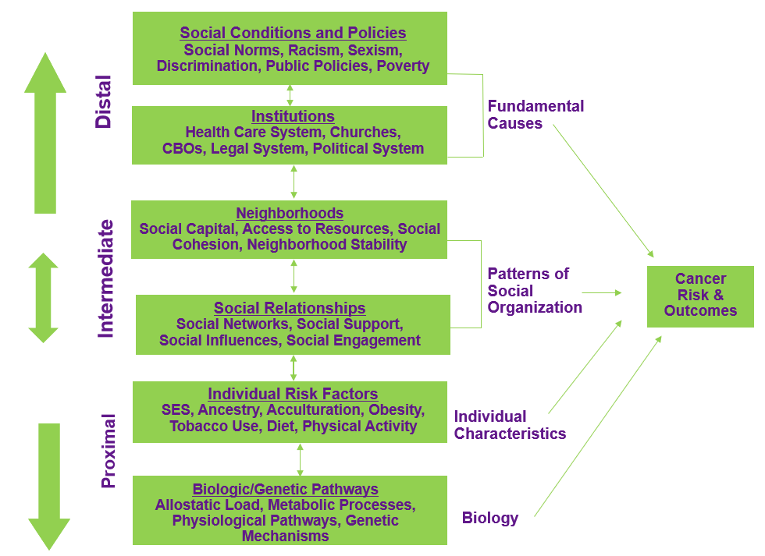
Social Determinants of Health
Adapted from: Warnecke, Oh, Gehlert et al., AJPH, 2008
Notes:
Health is determined by multiple factors beyond the quality and availability of healthcare.
Where an individual chooses to live can have a profound effect on their short- and long-term health.
Proximal (Biological, Intermediate, Distal)
Race or ethnicity, sex, sexual identity, age, disability, socioeconomic status, and geographic location all contribute to an individual's ability to achieve good health.

Slide 4
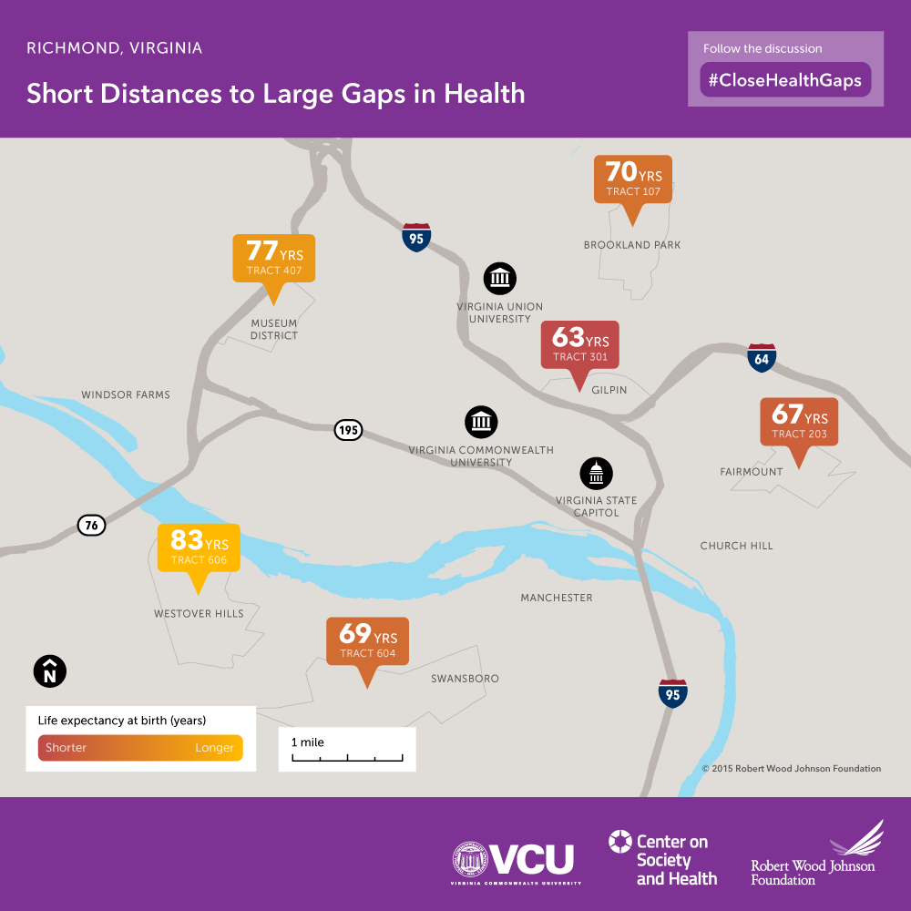
Place Matters
Notes:
Numerous studies have highlighted the critical links between health and education, income, and the quality of neighborhoods, among other factors

Slide 5
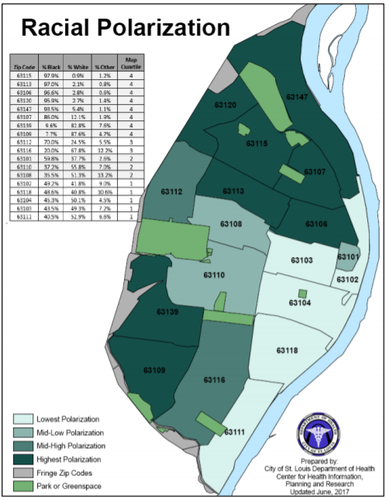
Black/African American ~98%
White ~98%
Notes:
115 Counties + Indepedent City: Zip codes in northern St. Louis City (63115, 63118, 63106, 63120, 63147, 63107) had the highest polarization of black/African American residents, with a range of 97.9% to 85.0%.
Zip codes in southwestern St. Louis City (63139, 63109) had the highest polarization of white residents.
The least polarized zip codes (63102, 63103, 63104, 63118, 63111) were in eastern St. Louis City,
where the percentages of black and white sub-groups were nearly equally distributed.
Ferguson 2014

Slide 6
The Landmark Health Disparities and Health Inequity Report

Slide 7
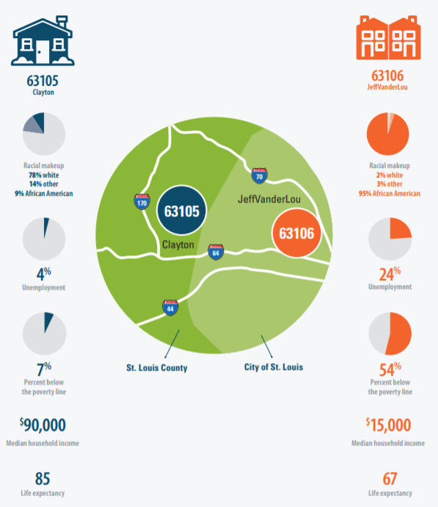
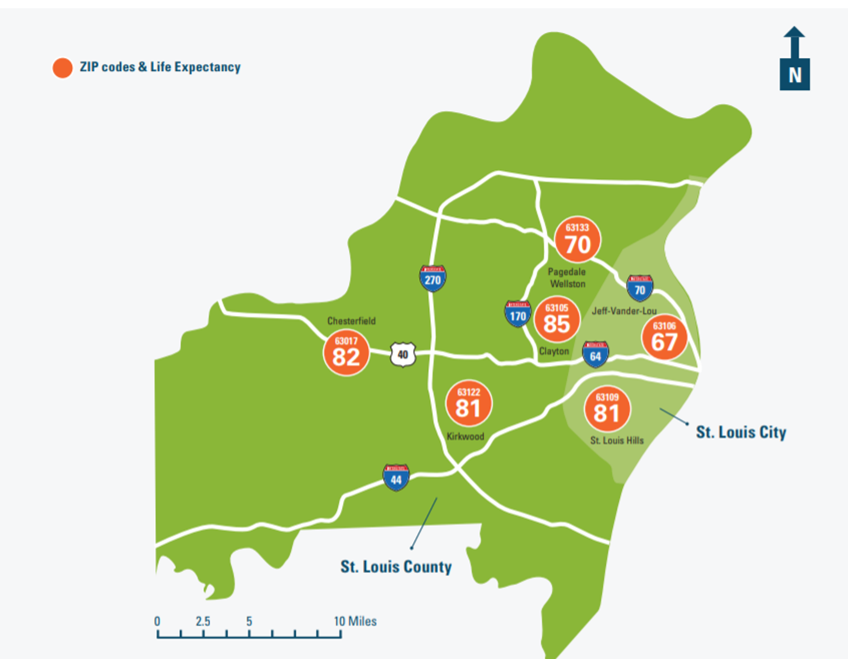
Notes:
Has the worst social and health indicators of the St. Louis area.

Slide 8
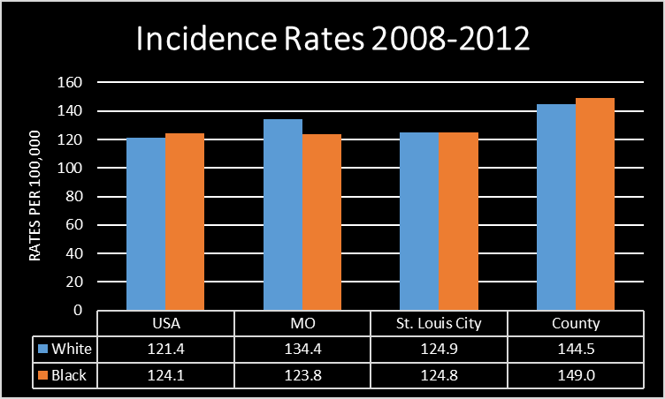
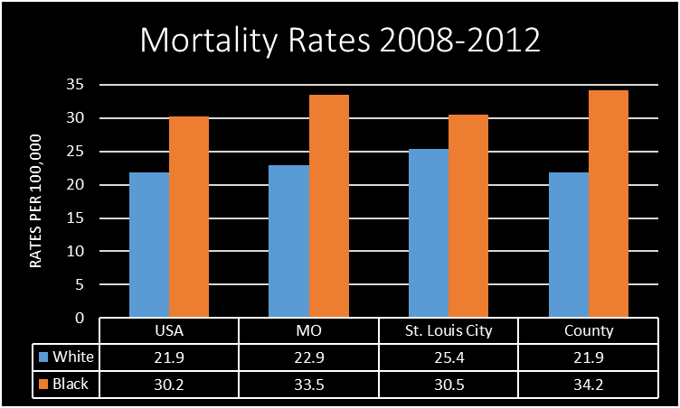
Breast Cancer Incidence & Mortality in St. Louis
Note: White rates are high because it includes Hispanics
Notes:
Why breast cancer disparities continue to widen in St. Louis?

Slide 9
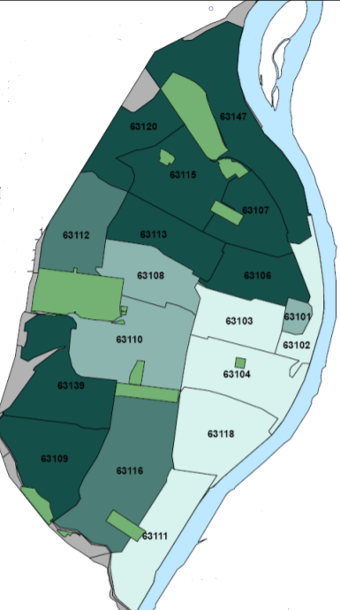
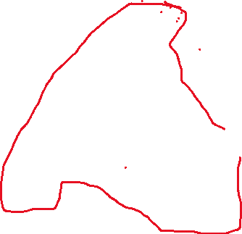
Areas of Concern
8 zip codes in North St. Louis
  63106
  63107
  63112
  63113
  63115
  63120
  63136 (St. Louis Co.)
  63147
98% of population is African American
Has the worst social and health indicators of the St. Louis area

Slide 10
Overarching Mission:
The Komen St Louis CBPR Project
Identify shortfalls or gaps in the breast cancer treatment of African American women living in North St. Louis City
(as measured by time to treatment)
that will help explain their disproportionate rates of breast cancer mortality compared to white women, with an ultimate goal of remedying these shortfalls or gaps
Academic Partners: WUSTL School of Medicine, Brown School of Social Work. Community Partners: Christian Hospital, Committed Caring Faith communities, Betty Jean Kerr People’s Health Clinic, & Women’s Wellness Unite of St. Louis Effort for AIDS

Slide 11
885
Analysis of MCR data
of African American women diagnosed between 2000-2008
(Specific Aim #1)
432 (alive in 2013)
St. Louis Komen Project Data Sources
96 interviewed
8 FGs = 88
Focus groups with patient navigators, providers & community residents to gain their perspective on BC treatment of women in sample & Develop a plan to build trust in North St. Louis
(Specific Aim #3)
Narrative interviews with survivors to capture treatment experiences: compared provider notes in their electronic medical records
(Specific Aim #2)
Multilevel Approach to St. Louis Komen Project
Notes:
Aim#2: Patient chart review of those interviewed and treated at one of our CBPR partner cancer centers
Aim #3: Develop and execute a plan for building trust in health research among healthcare providers and residents of North St. Louis. The Community Partnership Center, or CPC) was opened in the zip code with the highest mortality and lowest life expectancy at the time that the project began (i.e., 60615)

Slide 12
Komen St. Louis Project Result
Mean age of women at the time of diagnosis with breast cancer was 61.29 years (SD=15.2), with a range of ages from 24 years to 107 years old
50% of women never begin or finish breast cancer treatment
Notes:
Studies have suggested that treatment delays greater than 90-days may be associated with stage
migration

Slide 13
Do we really understand the underlying cause(s) of treatment delays?

Slide 14
To Fully Capture the Complexity of Breast Cancer Treatment Delay…
Transdisciplinary teams of investigators, practitioners and community stakeholders are needed to understand the issue and develop multi-level intervention(s)
Notes:
Engage stakeholders to understand social and environmental factors that causes women with suspicious mammogram not to seek treatment/start or finish treatment

Slide 15
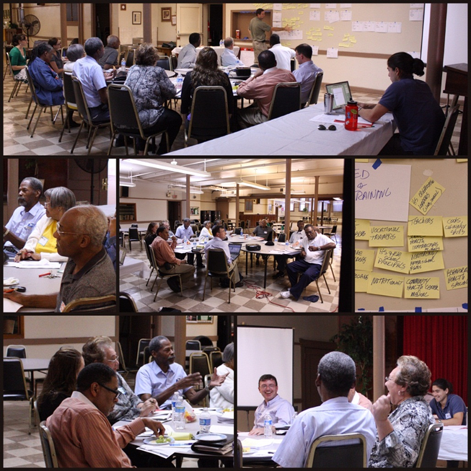
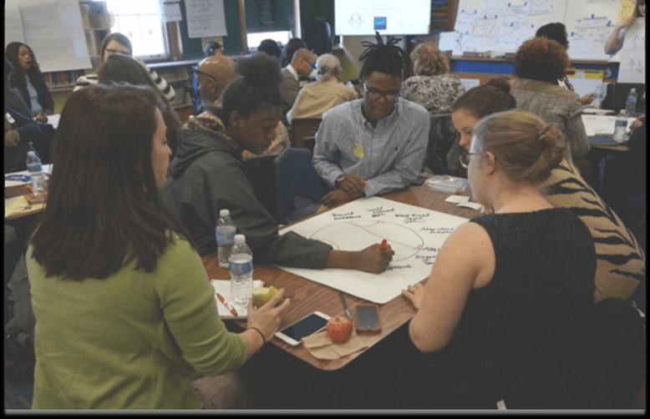
Approach
Community-based system dynamics or group model building (GMB)
Involves participants in process of building model
Emphasis:
  Community/stakeholder driven (capacity building)
  Sharing model insights
  Putting model into action
  Sustainability
Notes:
How to get the community involved?

Slide 16
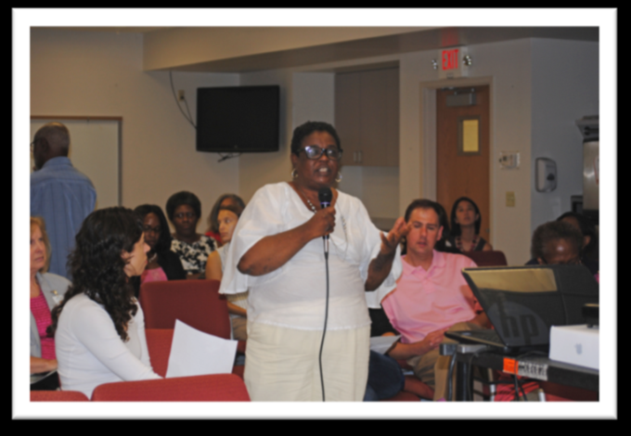
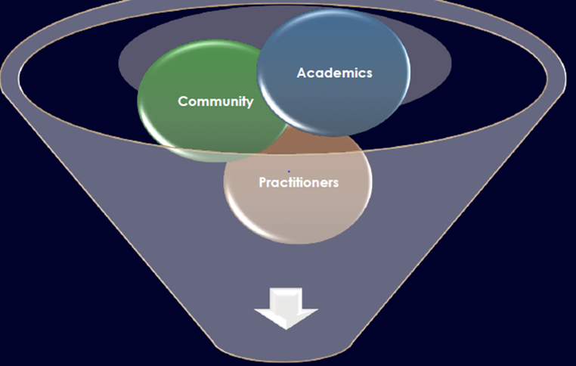
Goal:
Identify the reasons why African American women with a suspicious mammogram do not follow-up & those with confirmed diagnosis do not begin or delay breast cancer treatment &
Develop a causal loop diagram (CLD) or map of social determinants influencing breast cancer treatment delays

Slide 17
Multiple Iterations & Meeting
GMB
session
(stakeholder group)
Modeling
(GMB session
modeler)
Reflection and planning
(Special Community Workgroup)
Formation of Core Modeling Team (CMT)
3 Stakeholders Sessions
CMT work offline to put all models together

Slide 18
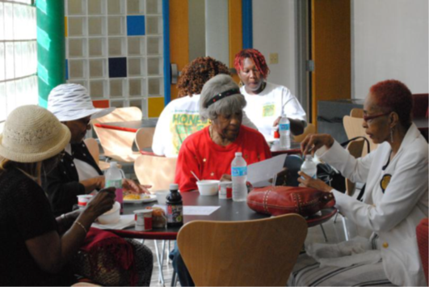
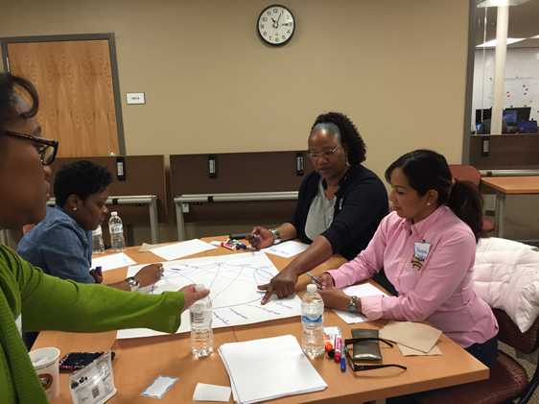
Study Population
Two Stakeholder groups
African American women from the community [n=28] (breast cancer survivors = 18 & family and caregivers = 10
Community support member [=6] (navigators, research coordinator, city worker & volunteers)

Slide 19
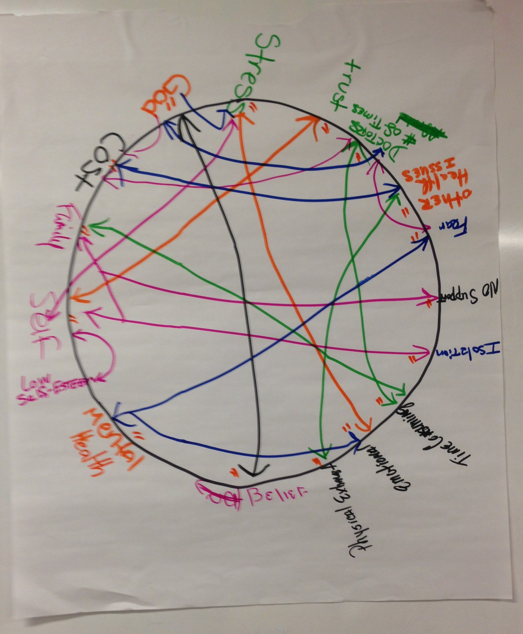
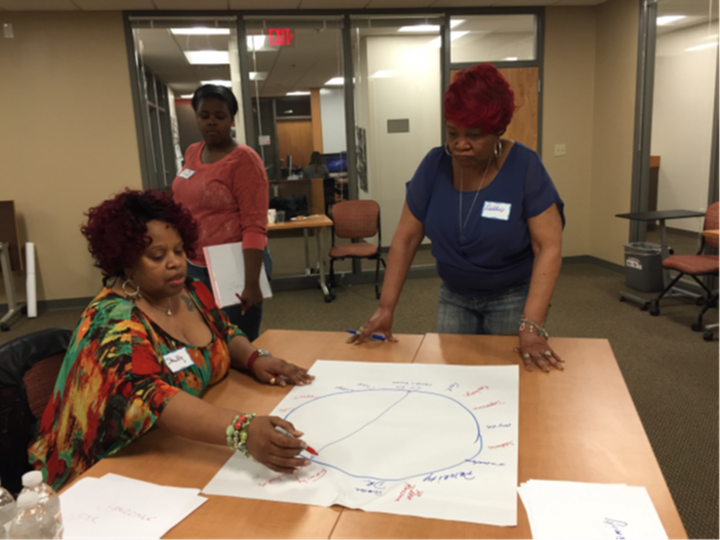
GMB Session Objective
First and second sessions were to elicit discussion on factors contribution to breast cancer treatment delays
Evaluate synthesized
  (Both Stakeholders)

Slide 20
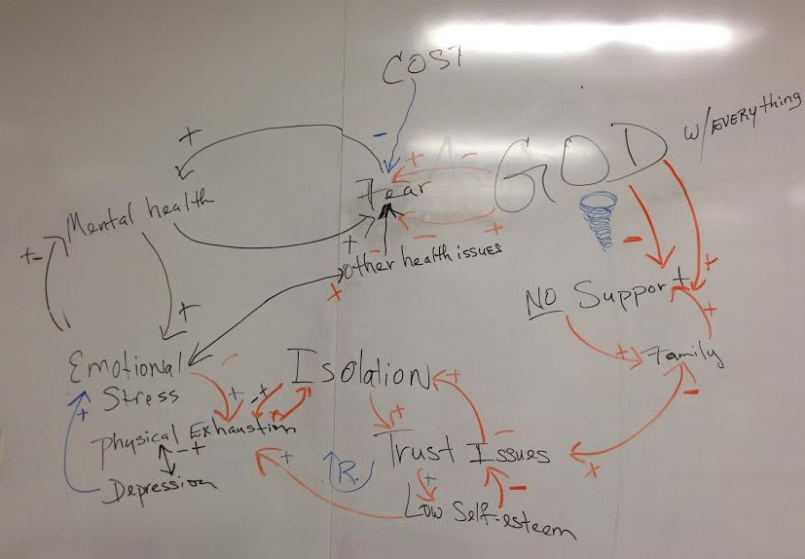
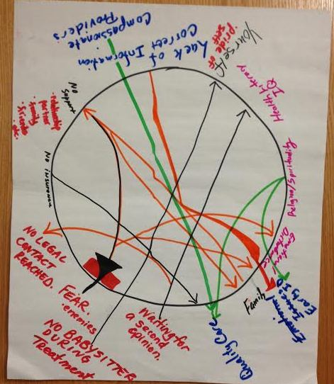
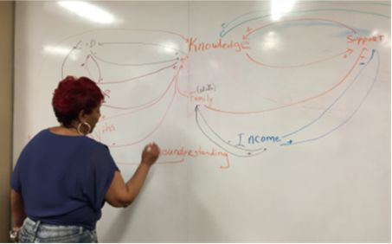
Example of Script Activities

Slide 21
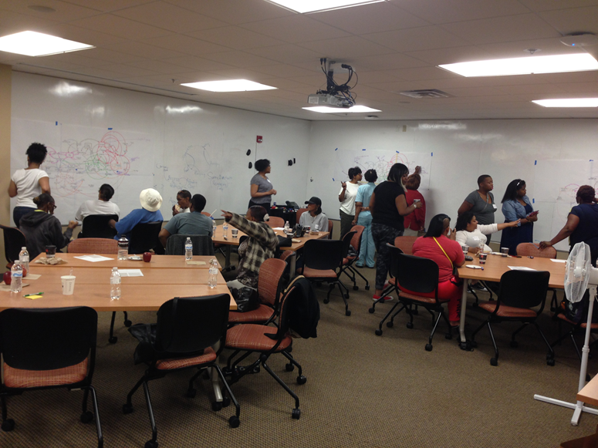
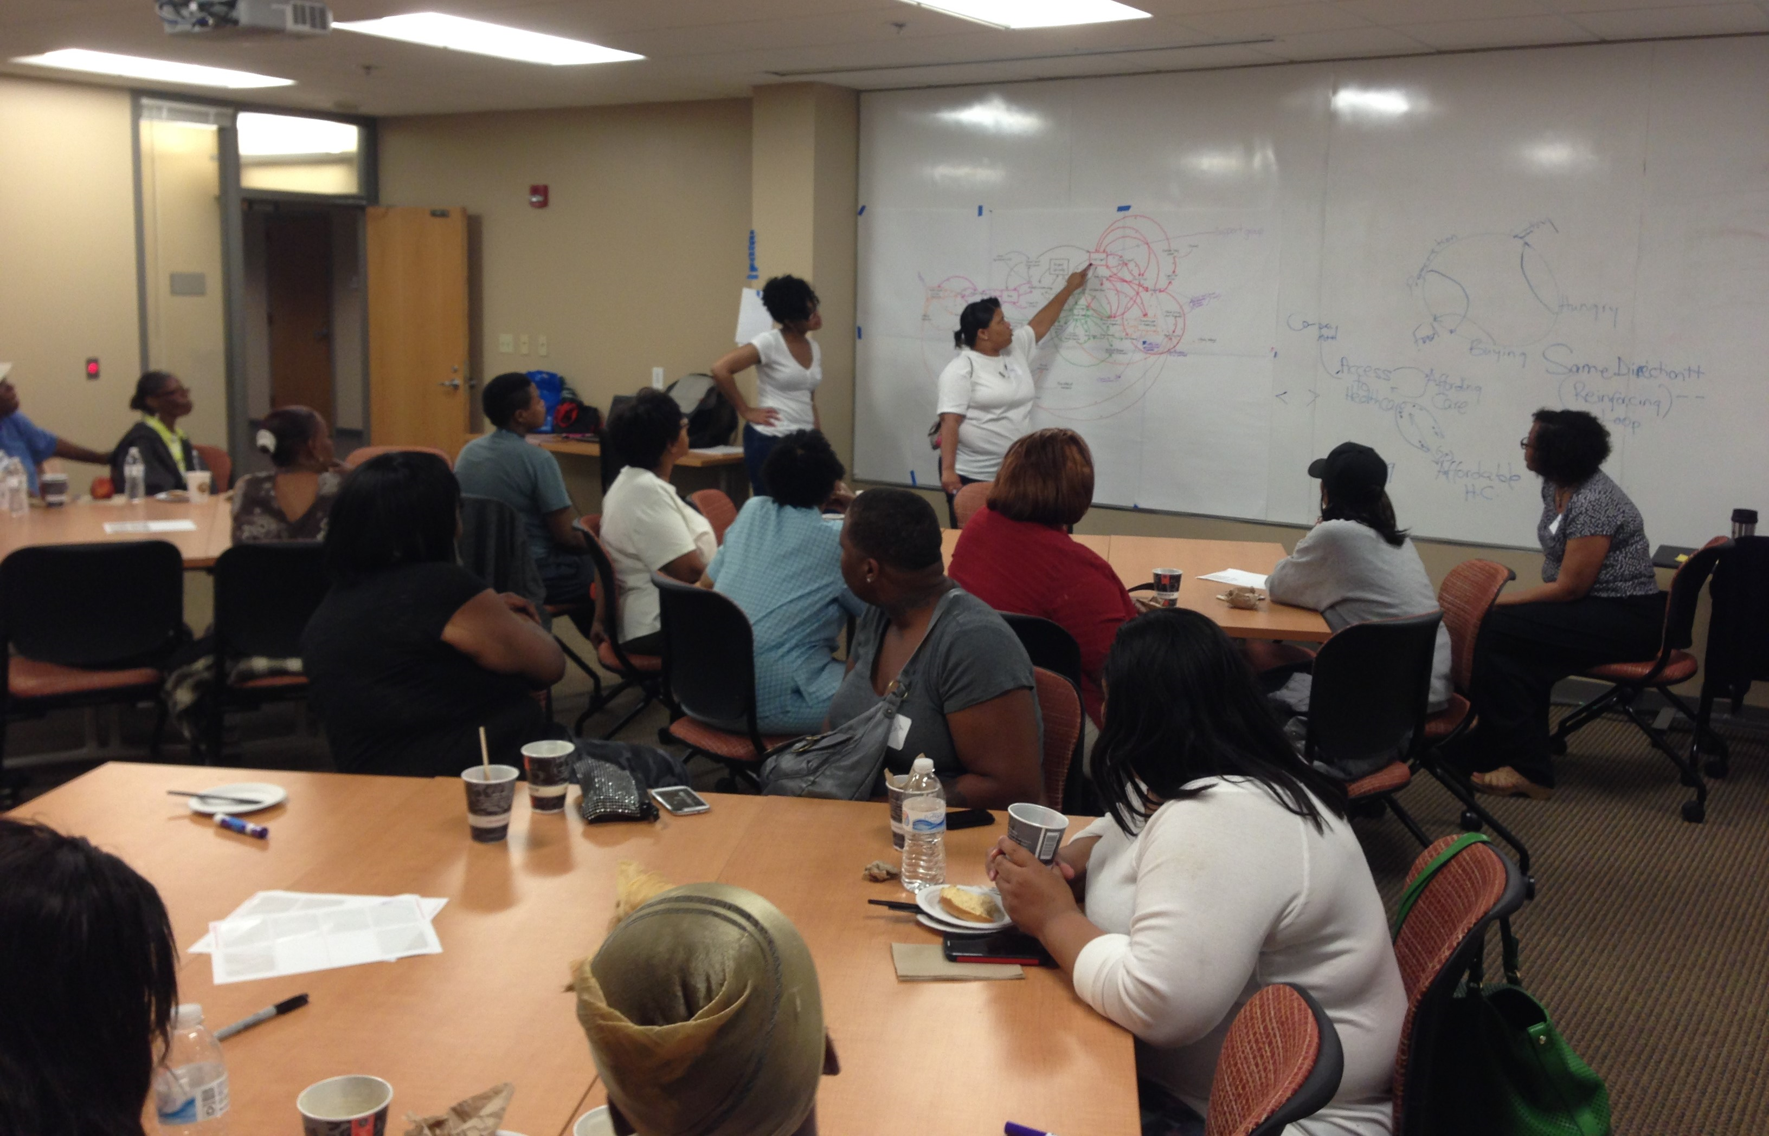
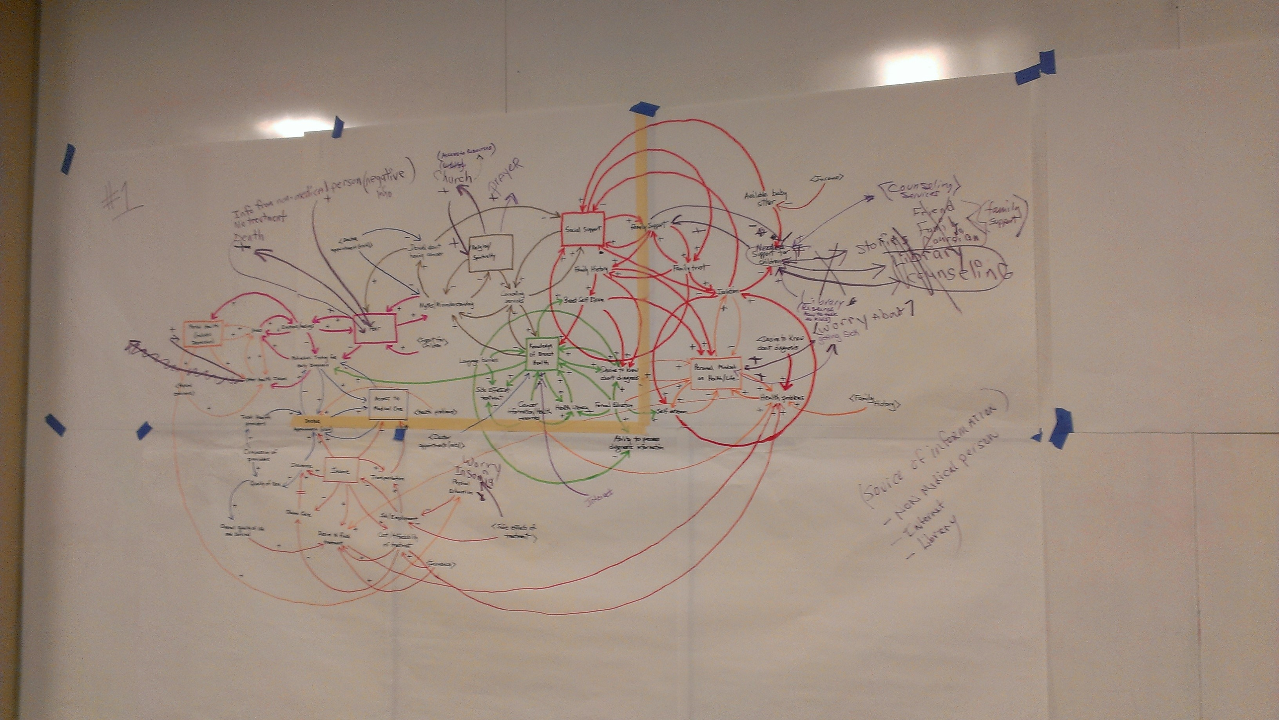
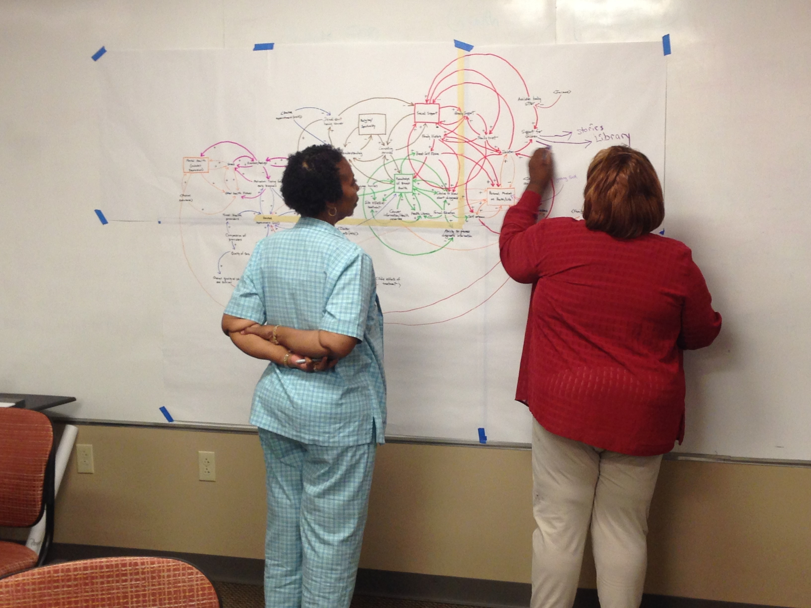
Third Session Evaluation of
Synthesized CLD (Both Stakeholders)

Slide 22
Findings

Slide 23
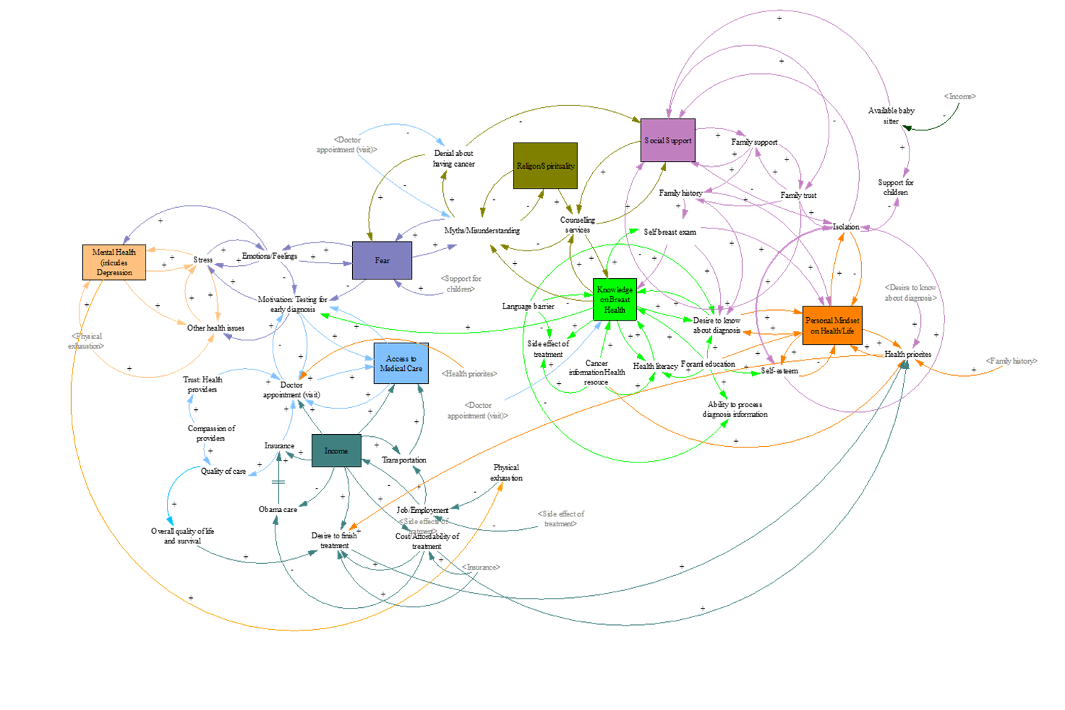
Mental Health
Fear
Income
Access to Medical Care
Religion/Spirituality
6. Social Support
Personal Mindset
about Health/Life
Knowledge on Breast
Health

Slide 24
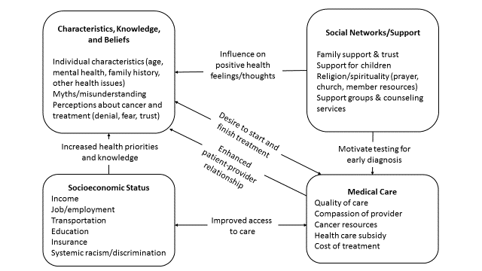
Summary of Factors Contributing to Treatment Delay

Slide 25
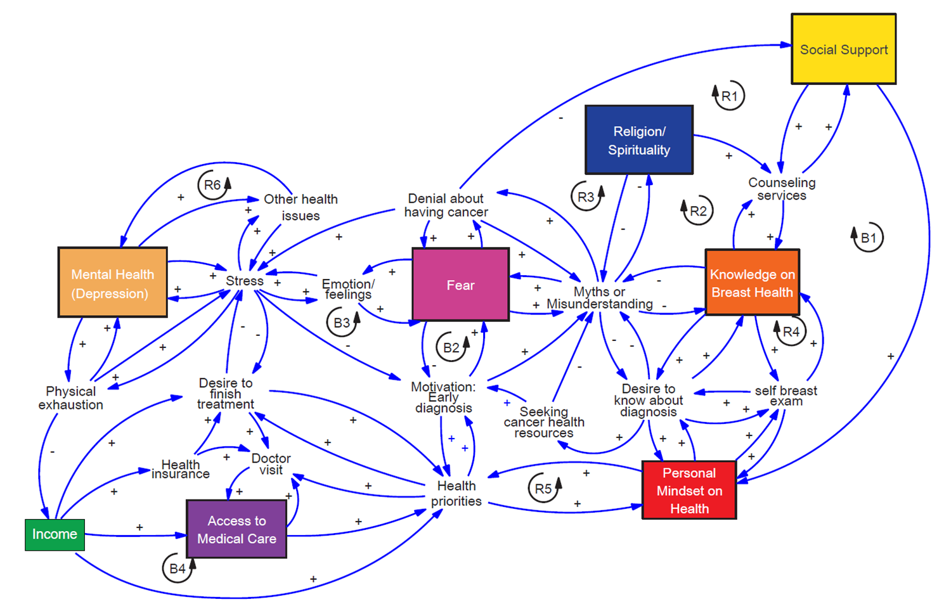
Refined and simplified model after condensing treatment delay factors identified by participants

Slide 26
Leverage Place of Influence to Promote Early Treatment

Slide 27
Summary and Main Insights
Spirit of togetherness and opening up to one another
Model enhanced their understanding on factors and also way of looking at problem
Intervention to instill and enhance breast health education and self-breast exam in school
Formation of community-based action group on women’s health
Rethink through how to present/deliver breast cancer news to patients especially fear (Nurses and Navigators)

Slide 28
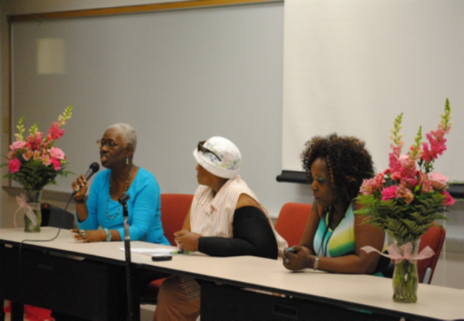
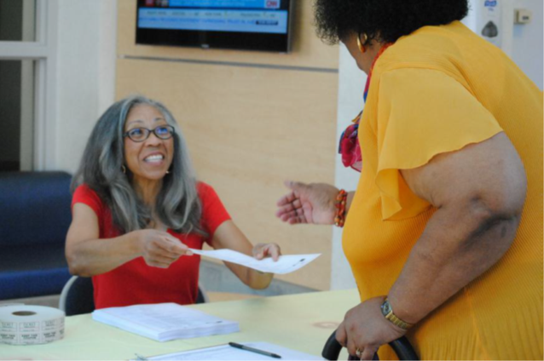
Disseminate Results
Produced and distributed a white paper to community, City of St. Louis Department of Health & academic partners
Town Hall meetings
Key note speaker at the ACS kick off Breakfast

Slide 29
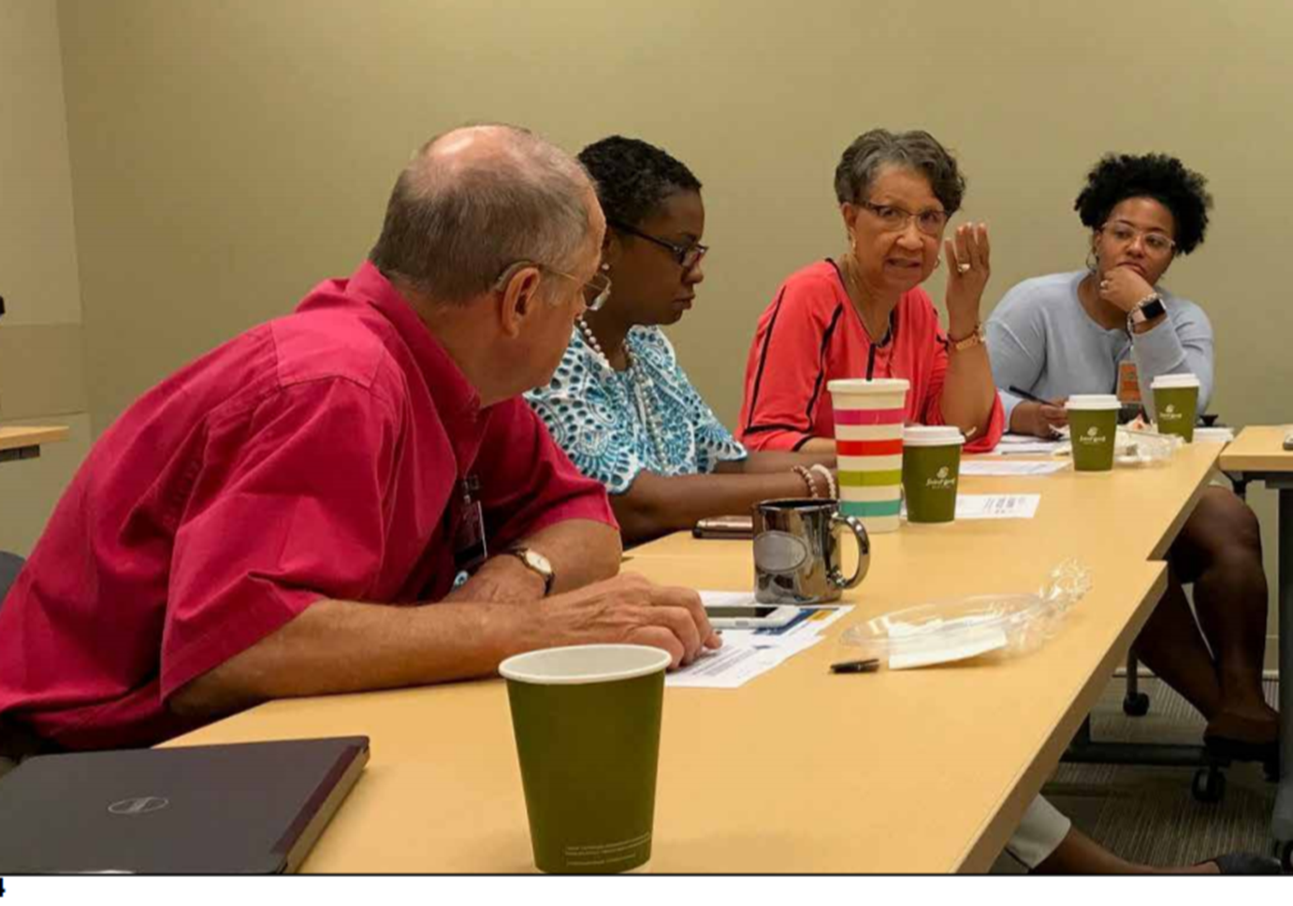
Action Plan
Formation of a community-based action group on women’s health
  Urban Warriors against Breast Cancer
Trained navigators on the issue of fear
Education of spouse/partners to
34-40% reduction in “no show” and treatment delay in North St. Louis!
Notes:
We found that rather than being linked with patient navigators directly at the time of diagnosis in FQHCs, navigators were given contact information for women after an appointment with the primary care physician who delivered the diagnosis. They reported that it is the most vulnerable women who are lost (i.e., those with the least stable housing, lowest health literacy, etc.).

Slide 30
Conclusion
Culturally sound intervention(s) are needed to encourage healthy lifestyle changes
Reducing breast cancer treatment delay requires comprehensive approach that involves community stakeholders, health care providers and academicians

Slide 31
Acknowledgment
EVMS
The wonderful women of North St. Louis
WUSTL School of Medicine
NIMHD Intramural Research Program/NIH
All Collaborators
HD & GeoTransD Research Team

Slide 32


Thank You!

