Slide 1
Transcreation: Developing a Translational Research Program to Improve Quality of Life among Latina Breast Cancer Survivors
Anna María Nápoles, PhD, MPH
Scientific Director
Division of Intramural Research
National Institute on Minority Health
and Health Disparities
Eastern Virginia Medical School
Brock Lecture
September 13, 2019

Slide 2
Outline
Transcreation: new translation model for health disparities communities
Nuevo Amanecer –stress management skills training program for Spanish-speaking Latina breast cancer survivors
Implications

Slide 3
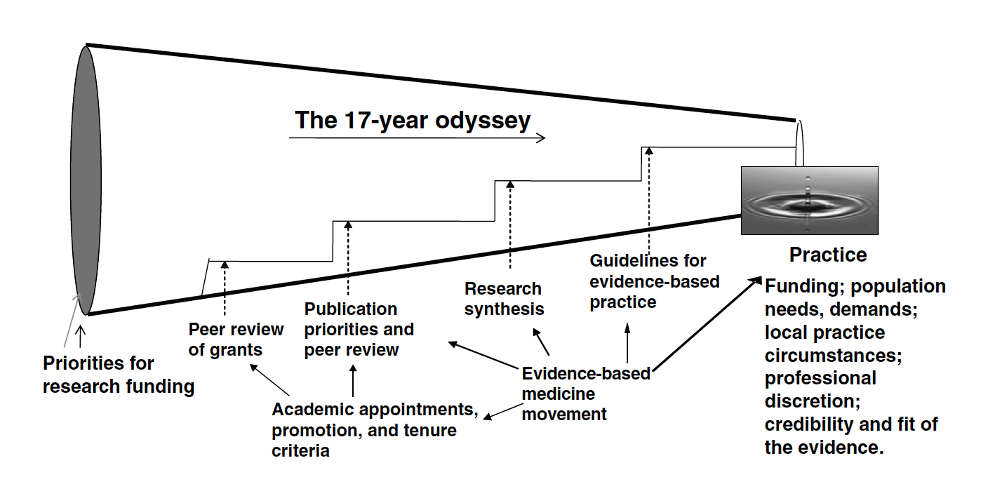
17 Years on Average to Translate
14% of Evidence to Patient Care
Green L et al 2009 Ann Rev Public Health

Slide 4

We Can Do Better
NIH Health Disparities Strategic Plan: develop, disseminate interventions to reduce disease and disability and improve health and QoL
Evidence-based interventions (EBI) available
Communities can provide programs
Not being implemented broadly, especially in minority communities
Notes:
McGlynn (2003) found that the U.S. population on average receives half of the recommended preventive and treatment services

Slide 5

Limitations of Standard Translation Models for Reducing Disparities
Research centered
Focuses on internal validity – strict protocol, ideal conditions
Emphasizes fidelity to original intervention
Limited community involvement
Overlooks implementation in real world settings, culture, diversity, social determinants
Takes too long!

Slide 6

Community- and Patient-engaged Transcreation

Slide 7
Transcreation
Marketing process whereby new messaging and content are developed or adapted for a given audience to resonate in local markets & deliver same impact as the original
Planning and delivering interventions to reduce health inequities so that they resonate with targeted health disparity community, while achieving intended health outcomes
Ray R and Kelly N 2010. Reaching new markets through transcreation.
Common Sense Advisory Council
.
Napoles & Stewart 2018 BMC Health Serv Res. 2018 Sep 12;18(1):710.

Slide 8


Tenets of the Community-Engaged
Transcreation Research Framework
Begin in disparities communities - real world setting
Include community – local resources
Use rigorous scientific methods in communities
Expand types of scientific evidence used
Incorporate ideas from locally developed programs
Build capacity for program implementation

Slide 9
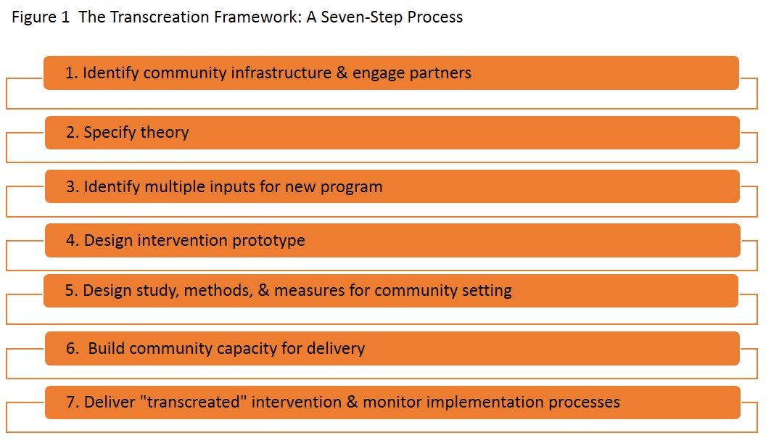
Napoles & Stewart 2018 BMC Health Serv Res. 2018 Sep 12;18(1):710.

Slide 10
Inequity: Poorer Health-related Quality of Life

Slide 11
Prevalence of Psychosocial Distress among Cancer Patients
Range: 22% to 58% in in general pop
Type of cancer only moderately associated with level of distress
Among newly diagnosed women with breast cancer, 47% reported distress scores > 5 on distress thermometer
11% major depression; 10% PTSD
Post-treatment cancer distress highest among younger non-white, less educated
Carlson LE, et al. 2012 J Clin Oncol 30(11):1160-77.
Hegel MT, et al. 2006 Cancer 107)12):2924-31.
Jim HS, et al. 2007 Ann Behav Med 34(2):200-8.

Slide 12
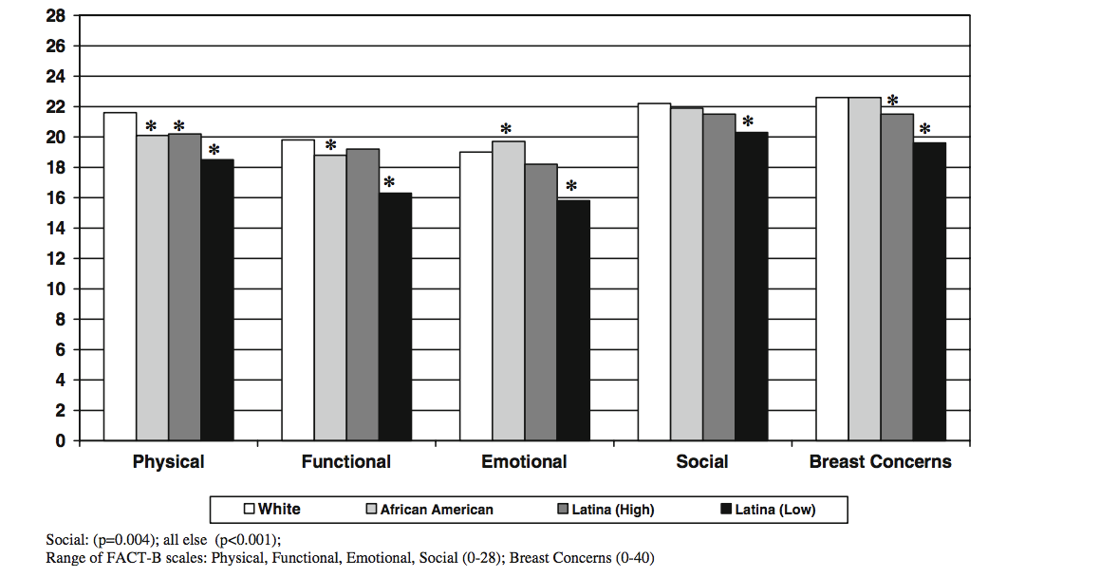
Unadjusted QoL Scores, Women with Non-Invasive Breast Cancer, Detroit & Los Angeles, 2005-07, N=1492
Janz NK et al. J Cancer Survivorship 2009 Dec;3(4):212-22

Slide 13
Unadjusted QoL Scores: Urban and Rural Latinas and White Women with Breast Cancer
For norms see: Brucker P et al. 2005. Eval Health Prof, 28(2)192-11
Notes:
Rural Span-speaking Latinas in NA-II (n=146)
Urban Span-spk Latinas in NA-I (n=151)
Norms based on 400 recently diagnosed white women with breast cancer

Slide 14
*
*p< .001 vs white women
Janz NK, et al. Cancer. 2008 Sep 1;113(5):1058-67

Slide 15
Latinas’ Psychosocial and
Symptom Management Needs
Fears of death, recurrence
Pain
Complications of adjuvant therapy
Body image, weight gain
Sexual functioning, partner rejection
Less knowledge about cancer and self-care
  Ashing-Giwa K. 2004 Psycho-Oncol;13:408-28
  Spencer SM. 1999 Health Psychol;18:159-68
  Eversley R. 2005 Oncol Nurs Forum; 32:250-6

Slide 16
Poorer Quality Communication with Physicians
Many do not understand their diagnosis and treatment
Less involved in patient-centered decision making
Even after treatment, are left with uncertainties and desire for information
Poorer symptom management
Nápoles-Springer AM. J Psychosoc Onc 2007. 25(4):19-36
Sheppard VB. Psychooncology; Jul 13 [Epub
Maly RC Breast Cancer Res & Treatment 2012: 119;707-16
Notes:
Rose Maly and colleagues at UCLA found among 222 breast cancer patients aged 55 or older that older patients and Latinas were received less informational support from their doctors controlling for a wide range of sociodemographic, psychosocial, and physician factors. They hypothesize that improving quality of communication at the patient-physician level may help reduce ethnic and age-related treatment disparities. MDs less often discussed treatment options, risk of recurrence.
In our CBPR project, 63% of Latinos who had not used support services indicated that if their oncologist had talked to them about it, they would have been more likely to use services.

Slide 17
Nuevo Amanecer
Research Program

Slide 18








Step 1: Identify Community Infrastructure
Engage Partners
Community-Academic Partnerships

Slide 19
Engaged Community in Finding Solutions
Qualitative interviews
    Overwhelming sense of fear and lack of control
    Lack of culturally & linguistically appropriate care
    Lack of social support
Population-based survey of 330 LBCS, 1-5 yrs since diagnosis
    22% reported functional limitations
    27% reported poor or fair self-rated health
    Cancer self-efficacy was independently associated with better self-rated health
Napoles-Springer A, et al. 2007 J Cancer Surv. Sep;1(3):193-204
Napoles-Springer A, et al. 2009 J Immigr Minor Health. Aug;11(4):268-80

Slide 20
Social Cognitive Theory
Step 2: Specify Theory
Intervention
Mechanisms
Outcomes
QoL
Distress
Anxiety
COPING SKILLS TRAINING
PEER SUPPORT
Coping
Self-efficacy
Support
Notes:
Coping skills training focuses on how to manage stress and communicate needs, ask for help.

Slide 21
Step 3: Identify Multiple Inputs for New Program
Community best practices
Evidence-based interventions
Interviews with survivors and advocates
Community Advisory Board

Slide 22

Community Best Practices
Support group members trained as peer support counselors
Provide one-to-one and family support
Explain surgery and treatment
    Link Latinas to health care and community resources
Círculo de Vida Cancer Support and Information Center

Slide 23
EBI Based on Social Cognitive Theory
Relaxation skills training
Cognitive restructuring
Communication skills
Build self-efficacy: goal setting, self-monitoring
Typically offered by psychologists in comprehensive cancer centers.
Graves KD, et al.2003 Palliat Supportive Care;1:121-134.
23

Slide 24
Cultural Factors Inform Adaptation
Latinas’ Needs | Intervention Delivery
Emotional support | PSC intervenes early with compassion, support
Difficulty expressing feelings, needs | PSC models expressive behaviors, reinforces practice of coping skills
Sense of powerlessness | PSC focuses on building self-efficacy, through self-care skills
Culturally competent services, language assistance | PSC interprets, translates, shares same background
24

Slide 25
Step 4: Design Intervention Prototype
Manuals from creator of CBSM for white women
Extracted core components of Las Angelitas
Iterative blending of both
Input from CAB and survivors

Slide 26
Adaptation to Community Settings
Simplified terminology and worksheets
Emphasized strengths
Delivery by peer – travels to client
Added skills for communication with family and MD (self-advocacy)
Rigorous translation and use of visuals & low-literacy text
Reviewed by CAB and CBOs
26

Slide 27
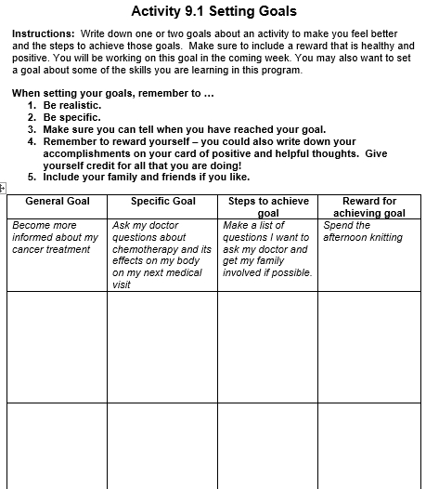
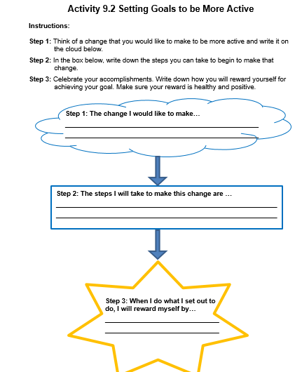
Adaptation: Simplified Activity Sheet
Nuevo Amanecer version
Nuevo Amanecer-Rural version

Slide 28
Nuevo Amanecer (A New Dawn)
8-week individualized intervention
Delivered by trained Latina BCS called Compañeras
Cognitive-behavioral stress management (CBSM) skills training and emotional support
Napoles AM, et al. Am J Public Health. 2015 Jul;105 Suppl 3:e55-63

Slide 29
Nuevo Amanecer Components
Finding cancer information
Getting support – communication skills
Managing thoughts & mood
Stress management
Managing activities that affect mood

Slide 30
Step 5: Design Study, Methods, and Measures for Community Settings
Meetings with CAB and community partners
Agreed on wait-list control group
Identified PROs as main outcomes
Pretested measures of hypothesized mediators
Identified community-oriented human subjects protection training
Napoles AM, et al. 2014 Clin Trials. Apr;1`1(2):230-8

Slide 31
Study Design
Latinas diagnosed with breast cancer <= 1 year
Primarily Spanish-speaking
Randomized to intervention or usual care control group (wait-listed)
5 San Francisco Bay Area counties, mostly urban

Slide 32
PROs: Baseline, 3 and 6 Months
Breast cancer-specific quality of life scales (FACT-B)
Breast cancer specific distress (Intrusive Thoughts scale
General symptoms of distress (BSI)
    Anxiety
    Depression
    Somatization

Slide 33
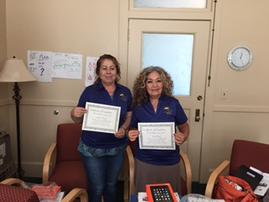
Step 6: Build Community Capacity for Delivery
Trained Community Recruiters and Interventionists

Slide 34
Training Community-based Staff
Recruiters (6) | Interventionists (8)
One 4-hour training session Prepared them to recruit, explain study, enroll, consent, and randomize Trained to conduct baseline assessments | Three 8-hr training sessions Detailed manual with audiovisuals Hands-on review Role playing and demonstrations Presentations on: Psychosocial issues among LBCS Theoretical basis of Nuevo Amanecer
Human subject’s protection training CITI website, or In person using CIRTification

Slide 35
Step 7: Deliver ‘Transcreated” Intervention &
Monitor Implementation
Rigorous Process Evaluation
Compañera tracked delivery and participant comprehension
Observer ratings of delivery of sessions
Participant post-intervention satisfaction survey
Debriefing interviews – community staff and participants
Napoles AM, et al. 2018 J Cancer Educ. Aug;33(4):875-84

Slide 36
Mixed Methods Evaluation
77% recruitment rate (151/195)
95% 6-month retention (144/151)
82% completed at least 6 of 8 sessions
Observer ratings: interventionists demonstrated fidelity 80-90% of the time for 3 components (e.g., following the manual), but only 10% for 2 components (e.g., modeling skills)
Knowledge and skills mastery was high (>85%)
93% indicated the program helped them cope with breast cancer “quite a bit/extremely”
Napoles AM et al. 2018 J Cancer Educ. Aug;33(4):875-84

Slide 37
Sample Characteristics
Average age at diagnosis = 50
About 70% Mexican; 25% Central Am
Lived in U.S. for 20 years on average
84% <high school education
78% had trouble paying their monthly expenses in past year

Slide 38
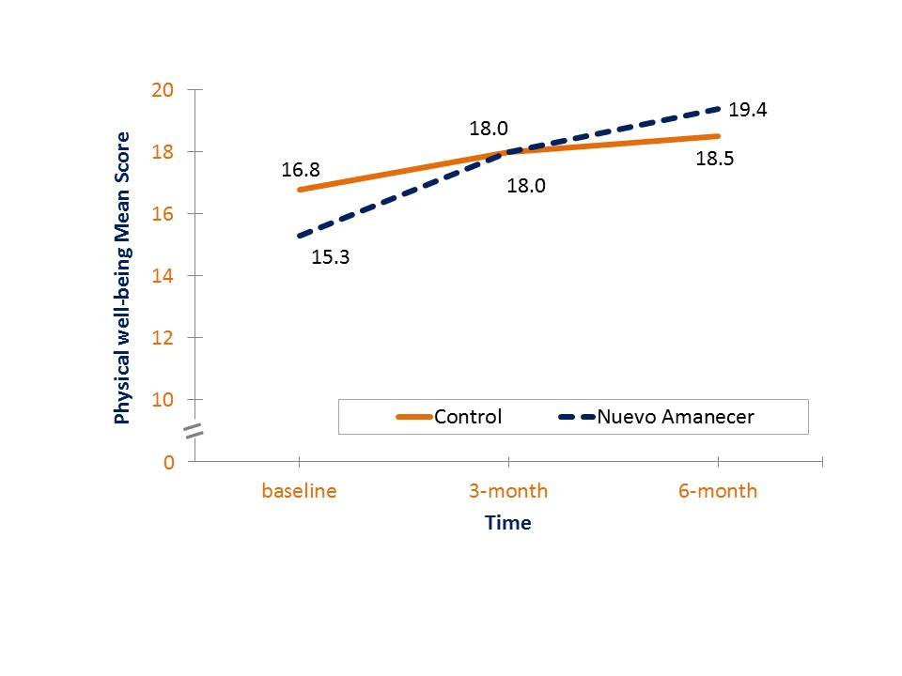
FACT-B Physical well-being (range 0-24)
p = 0.015

Slide 39
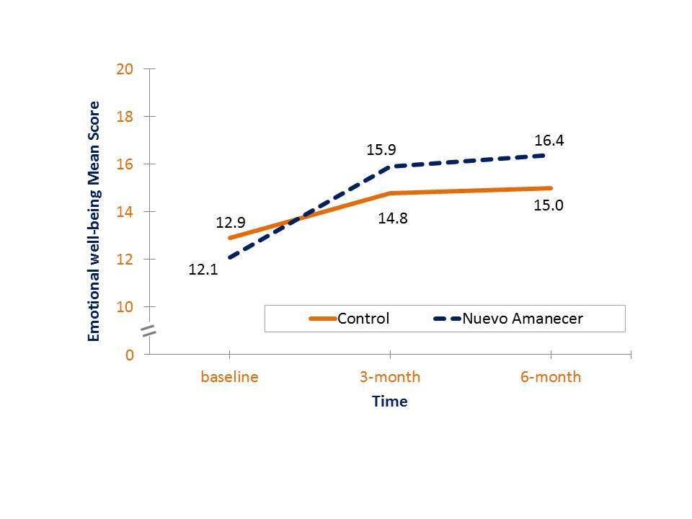
FACT-B Emotional well-being (range 0-20)
p = 0.004

Slide 40
Summary of Results
Improved...
    Physical well-being
    Emotional well-being
    Overall quality of life
Decreased…
    Breast cancer concerns
    Depressive symptoms
    Somatization

Slide 41
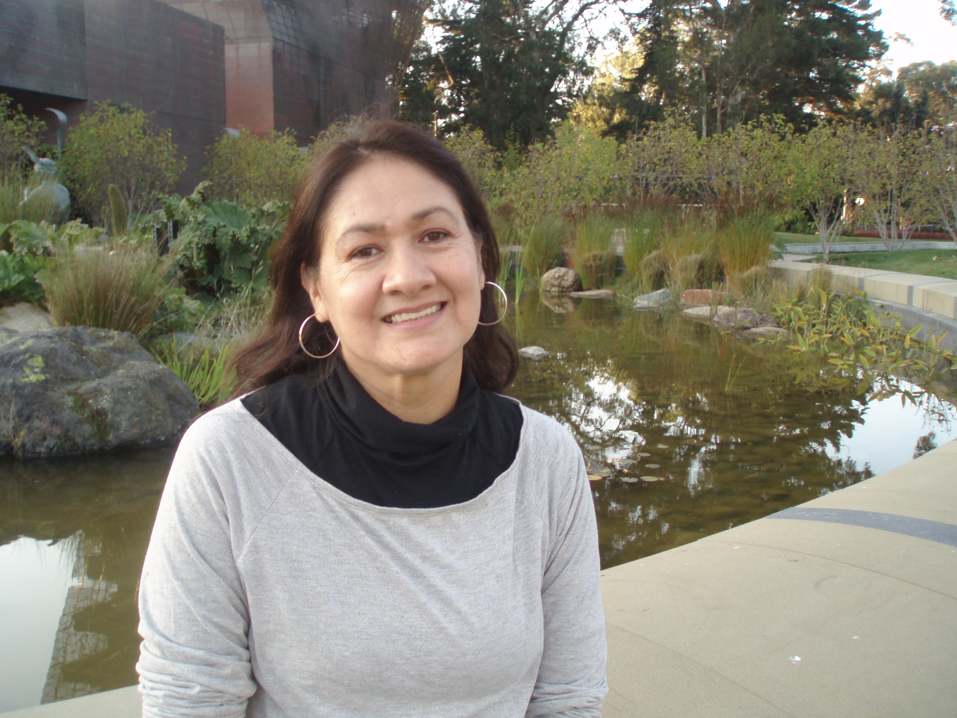
“The program changed me because it put me in higher spirits, made me happier, and helped me think positive thoughts so I could push forward and fight.”

Slide 42
Program of Translation Research

Slide 43
Translation Study 1
Population: rural Latinas with breast cancer, including U.S.-Mexico border (N=153)
Method: Peer-to-peer delivery
Biomarkers
  cortisol levels – biomarker of chronic stress
  telomere length - robust indicator of biological age and overall health
94% retention at 6 months

Slide 44
Translation Study 1
Rural Latina BCS
6-month RCT of 10-week Nuevo Amanecer program
Rural Spanish-speaking Latina BCS living in rural Imperial Valley, Central Valley & Salinas/Watsonville
153 women randomized to NA vs. wait-list
Mean age = 55 years (range 28-88)
> 50% have Medicaid/no insurance
70% < high school education
About half report financial hardship
97% Mexican origin

Slide 45
Translation Study 1
Rural Latina BCS (n=153)
Survey to Assess Primary Outcomes
90% retention at 3 months
92% retention at 6 months

Slide 46
Participant-centered Biospecimen Collection Results
103 Rural, Low SES
Latina Breast Cancer Survivors
 | Baseline (%) | 6-mo. Follow-up (%)
Saliva samples (9) for CAR analysis | 89 | 76
Saliva buccal cells (DNA) for telomere length analysis | 97 | 85
Samayoa C. in preparation
Notes:
Used multimedia aides, CHWs trained by researchers collected specimens, simplified types of samples and protocol.

Slide 47
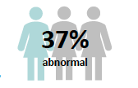

Translation Study 1
Preliminary Results
Baseline
Cortisol Awakening Response (CAR) measure the activity of the HPA axis; curves that demonstrate a cortisol peak 30 minutes after awakening and a cortisol dip bedtime were considered normal (Samayoa C)
Ability to Relax at Will
Group x Time Interaction: Intervention vs. Wait-List Control
(baseline, 3-mo, 6 mo. assessments)

Slide 48
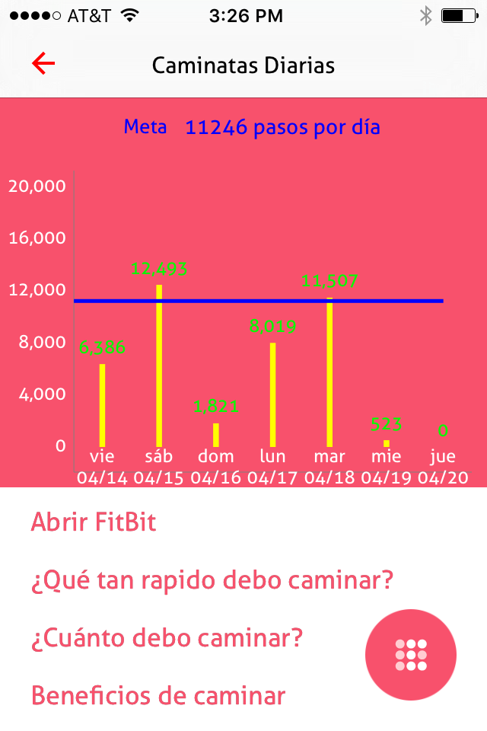
Translation Study 2
mHealth + telephone coaching
2-month pilot study among Spanish-speaking Latinas
Improved fatigue, health distress, emotional well-being
Increased knowledge of follow-up care
Increased average daily steps by 1,311

Slide 49

Translation Study 3
Population: rural low-income No. California
Delivery method: telehealth peer support and navigation

Slide 50
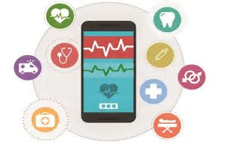
Translation Study 4
Population: low-income urban women receiving chemotherapy for breast cancer
Delivery method: mobile phone app in Spanish and English with telephone coaching

Slide 51

Implications:
Building Blocks of Transcreation
  Engage patients and communities
  Build community capacity to deliver EBIs
  Integrate translation efforts to learn what works, for whom

Slide 52
Implications
Vulnerable groups are willing to participate
Translate EBIs to vulnerable communities to address high cancer symptom burden
Trained CHWs can provide CBSM training, addressing shortages of culturally appropriate psycho-oncology services

Slide 53
“The intervention development process is incomplete until an intervention is optimally efficacious and implementable with fidelity by practitioners in the community.”
Making a Difference
Onken LS, et al. 2014 Clinical Psychol Science;2(1):22-34

Slide 54
Acknowledgements
Community partners, Latinas living with breast cancer, wonderful staff!
  California Breast Cancer Research Program, University of California grant nos. 15BB-1300, 15BB-1301, 21OB-0135
  National Cancer Institute grant no. 1R21CA182536
  Susan G. Komen grant no. IIR13265366 with matching support from the UCSF HDFCCC
  National Institute on Aging grant no. P30 AG15272
  NIMHD Intramural Research Program

Slide 55
Resources
For program manuals: anna.napoles@nih.gov
Publications
Nápoles AM, et al. Results of a RCT of a community-based, peer-delivered stress management intervention to improve quality of life in Latinas with breast cancer, American Journal of Public Health, 2015 Jul;105 Suppl:55-63.
Nápoles AM, Santoyo-Olsson J, Ortiz C, Gregorich S, Lee HE, Duron Y, Graves K, Luce JA, McGuire P, Diaz-Mendez M, Stewart AL. Randomized controlled trial of Nuevo Amanecer: a peer-delivered stress management intervention for Spanish-speaking Latinas with breast cancer, Clinical Trials, 2014; Apr;11(2):230-8.
Nápoles AM, Stewart AL. Methods for translating evidence-based behavioral interventions for health disparities communities. Preventing Chronic Disease, 2013 Nov 21;10:E193.

